Slide 1

Afghanistan the unhappy end of a
20-year conflict

Slide 2
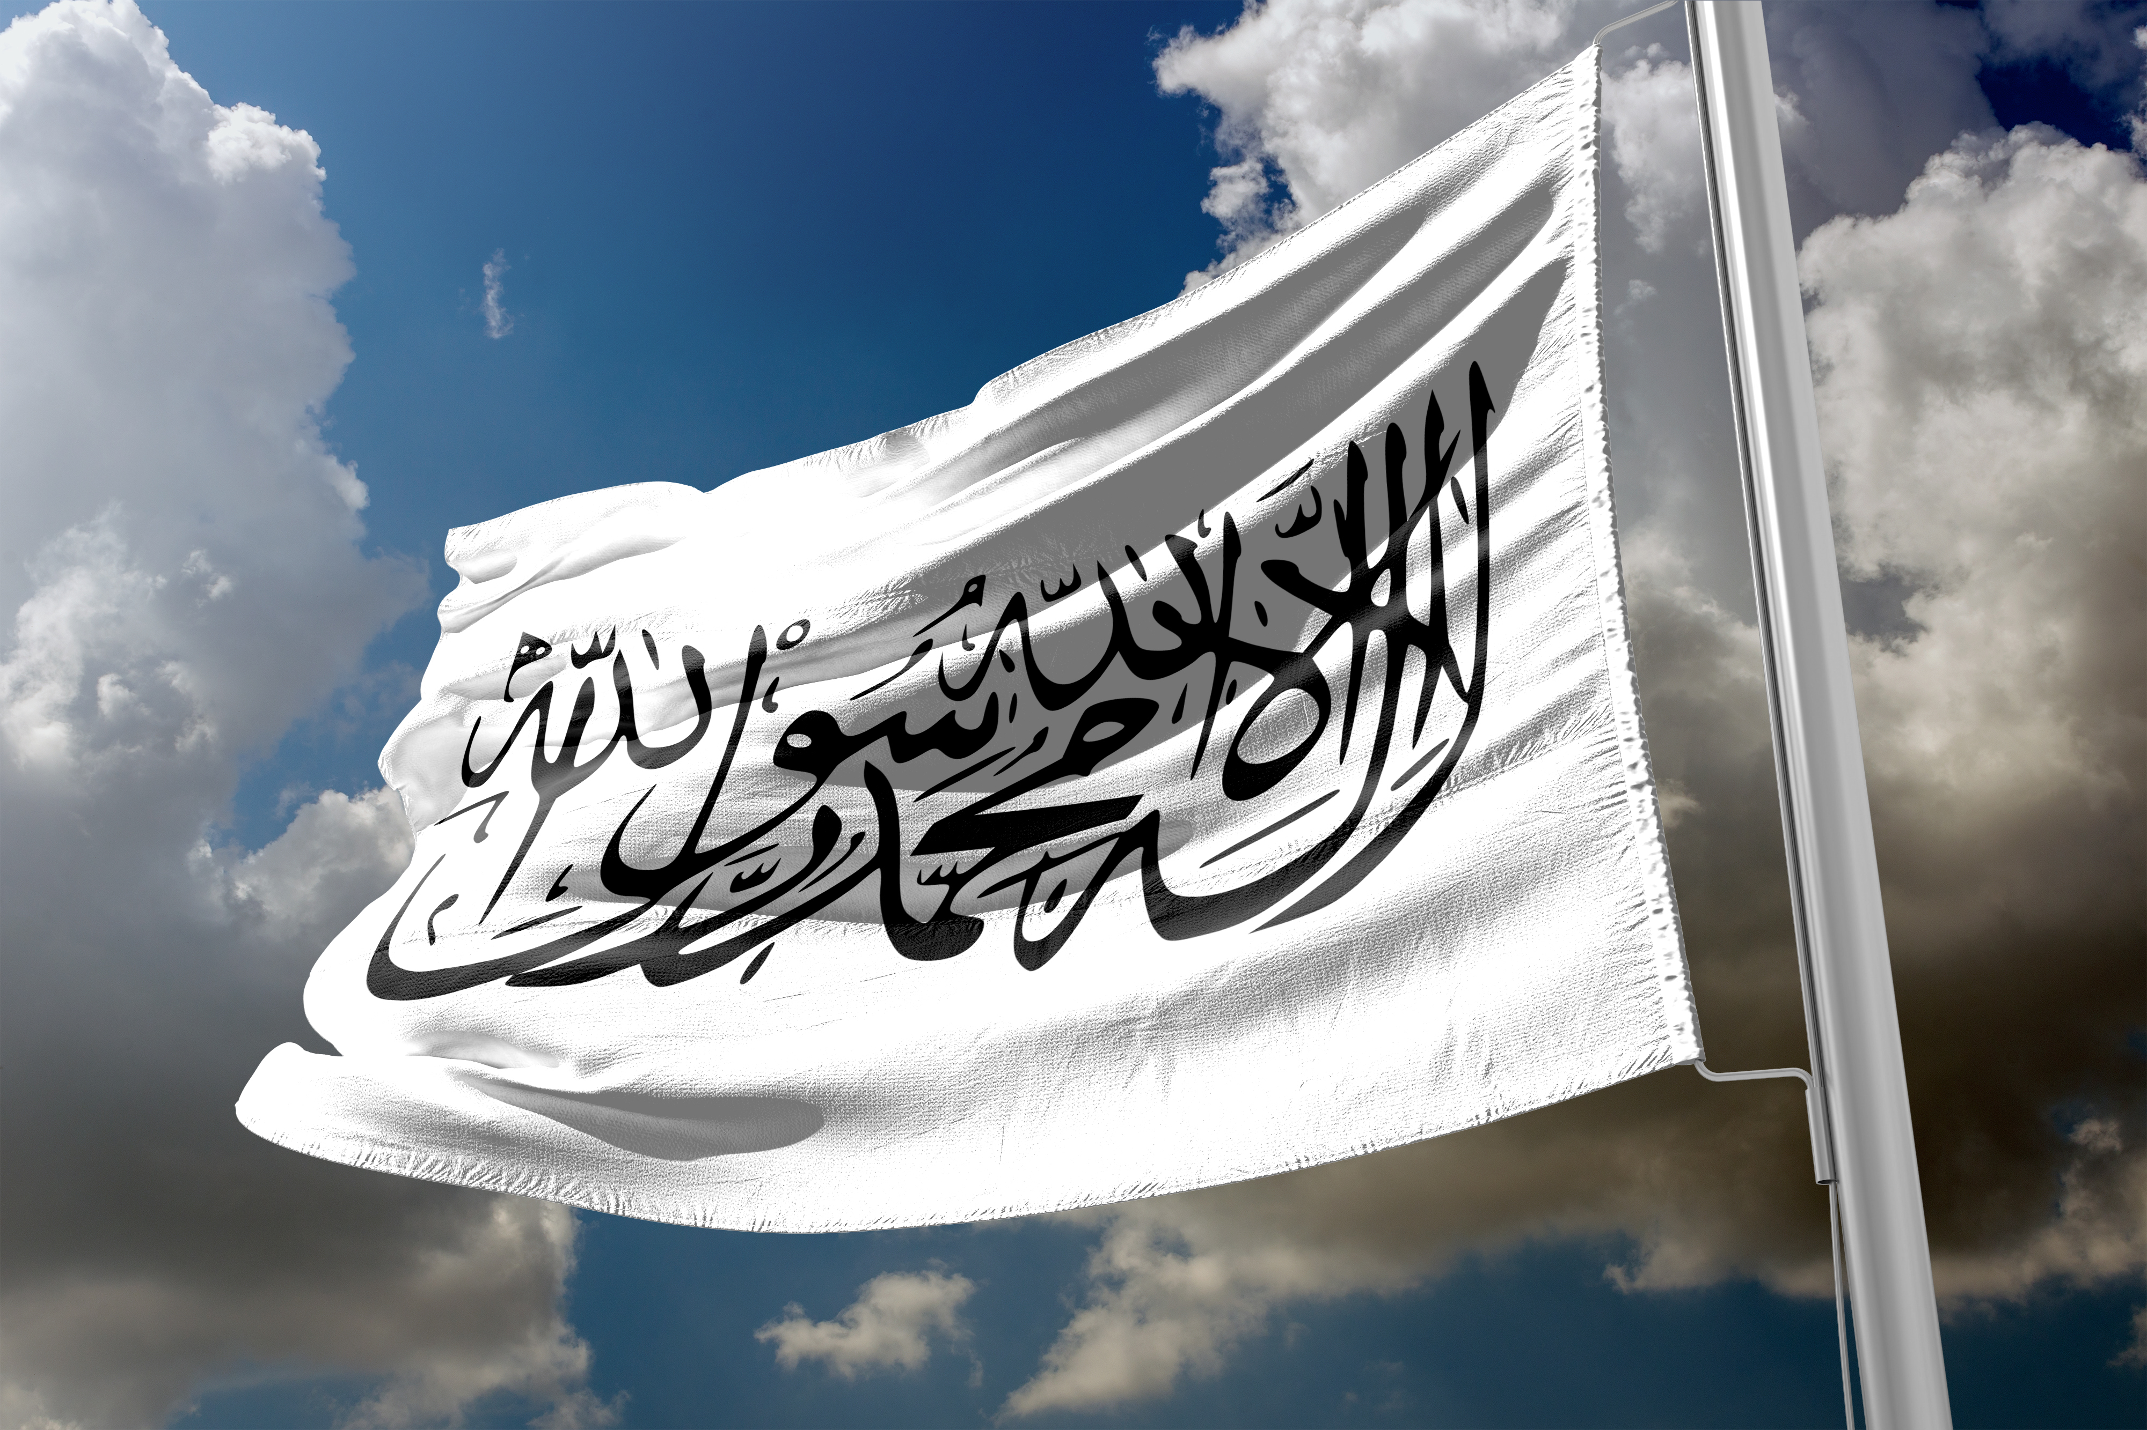
The Taliban flag (1996-2001; 2021 - )
The Taliban flag – a white flag bearing a text called the Shahada
“La ilah ila Allah, Mohammad rasoul Allah” (There is no god but God and Muhammad is God’s messenger)

Slide 3
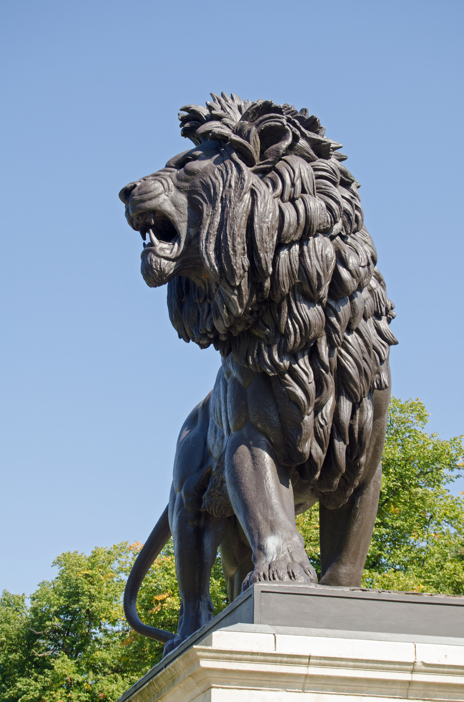
The “Maiwand Lion” – memorial in Forbury Gardens, Reading

Slide 4
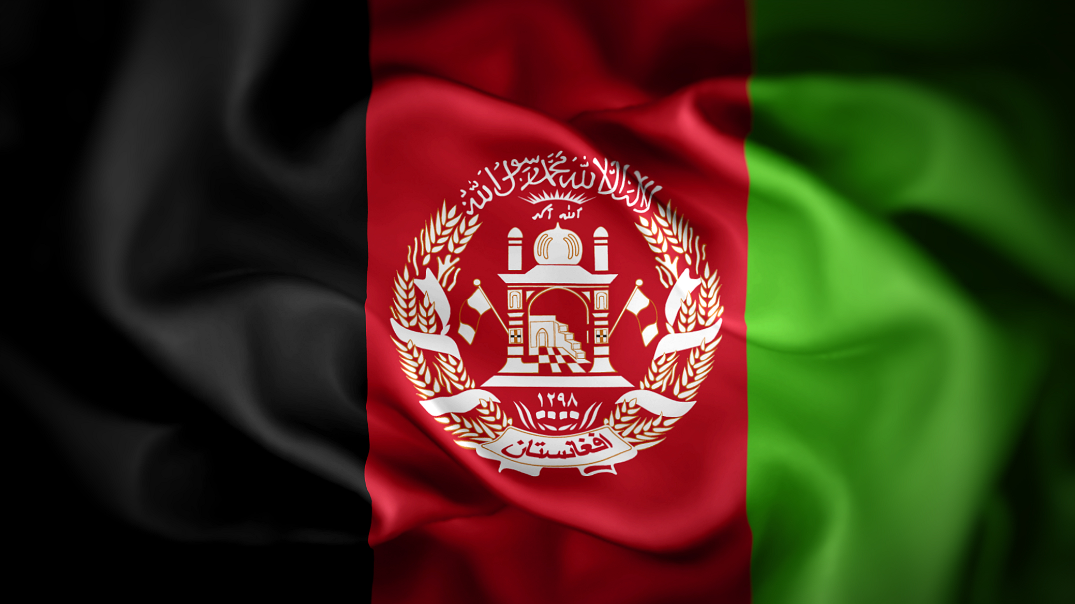
Flag of Afghanistan – 2013-2021

Slide 5
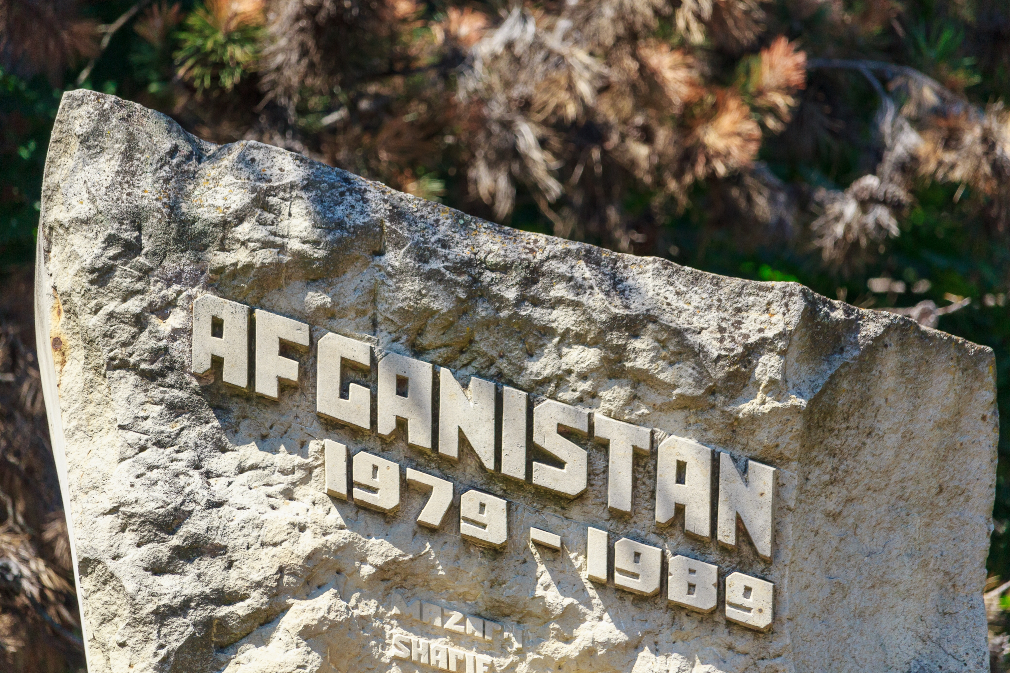
Soviet troops withdraw from Afghanistan 1989

Slide 6
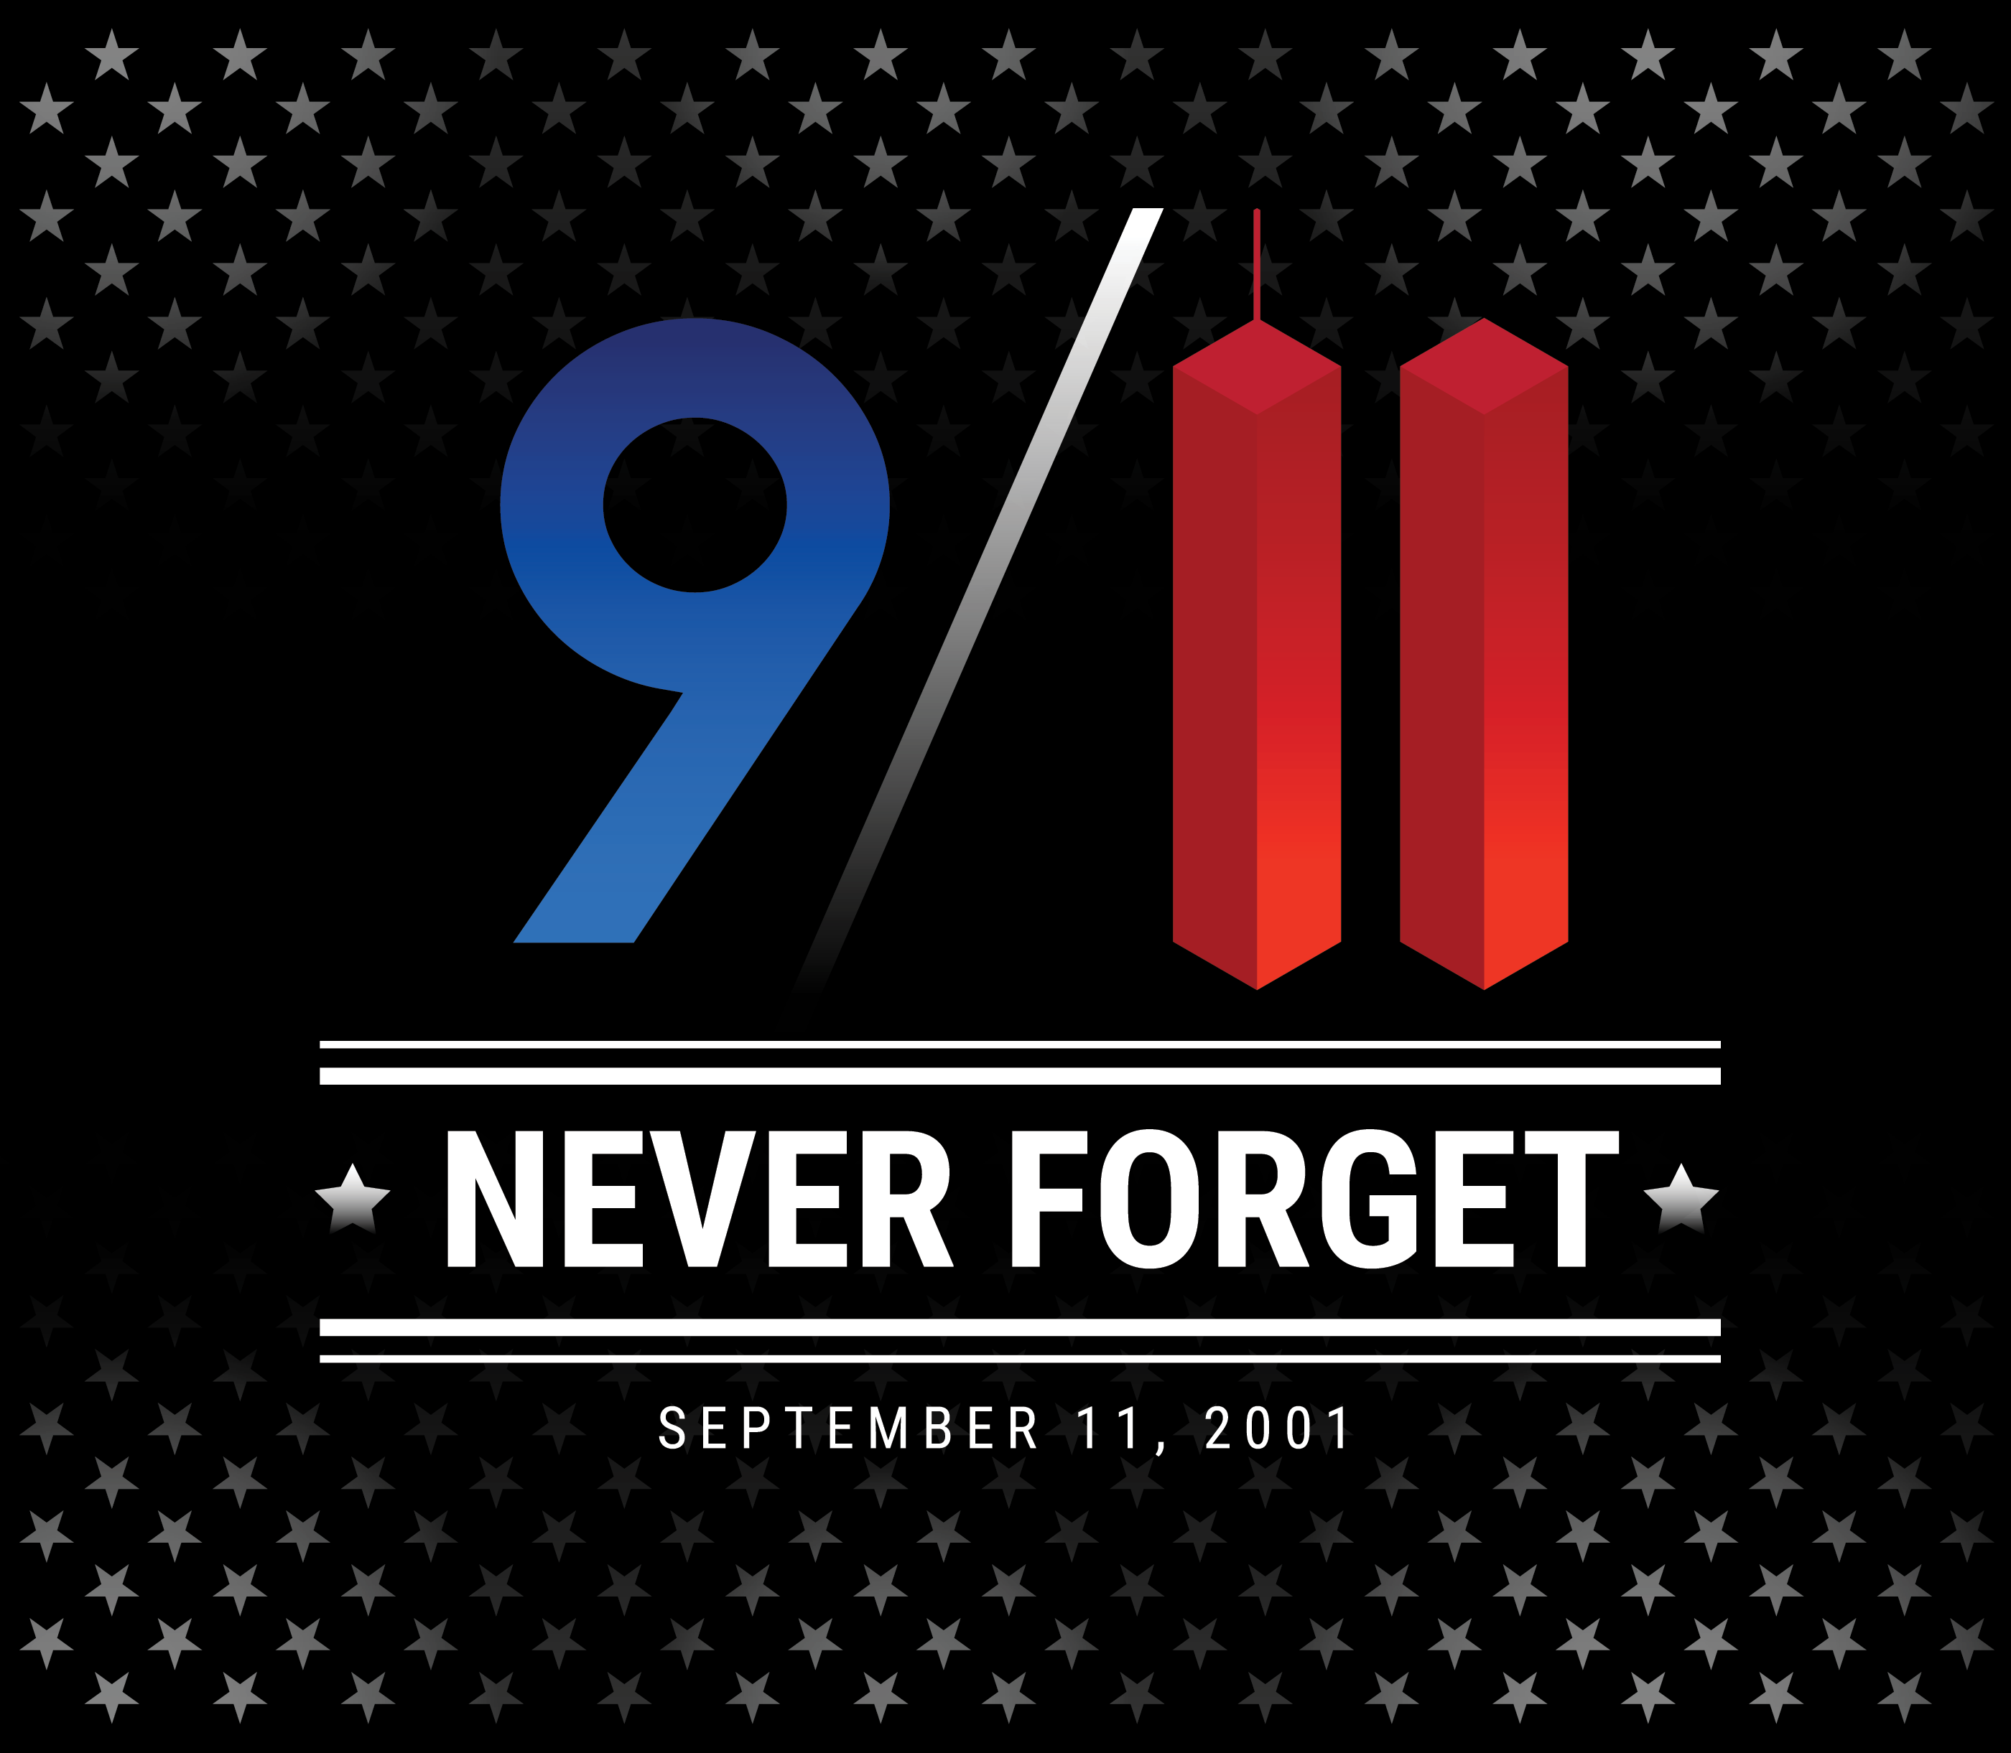
“9/11” – The attack on the USA

Slide 7
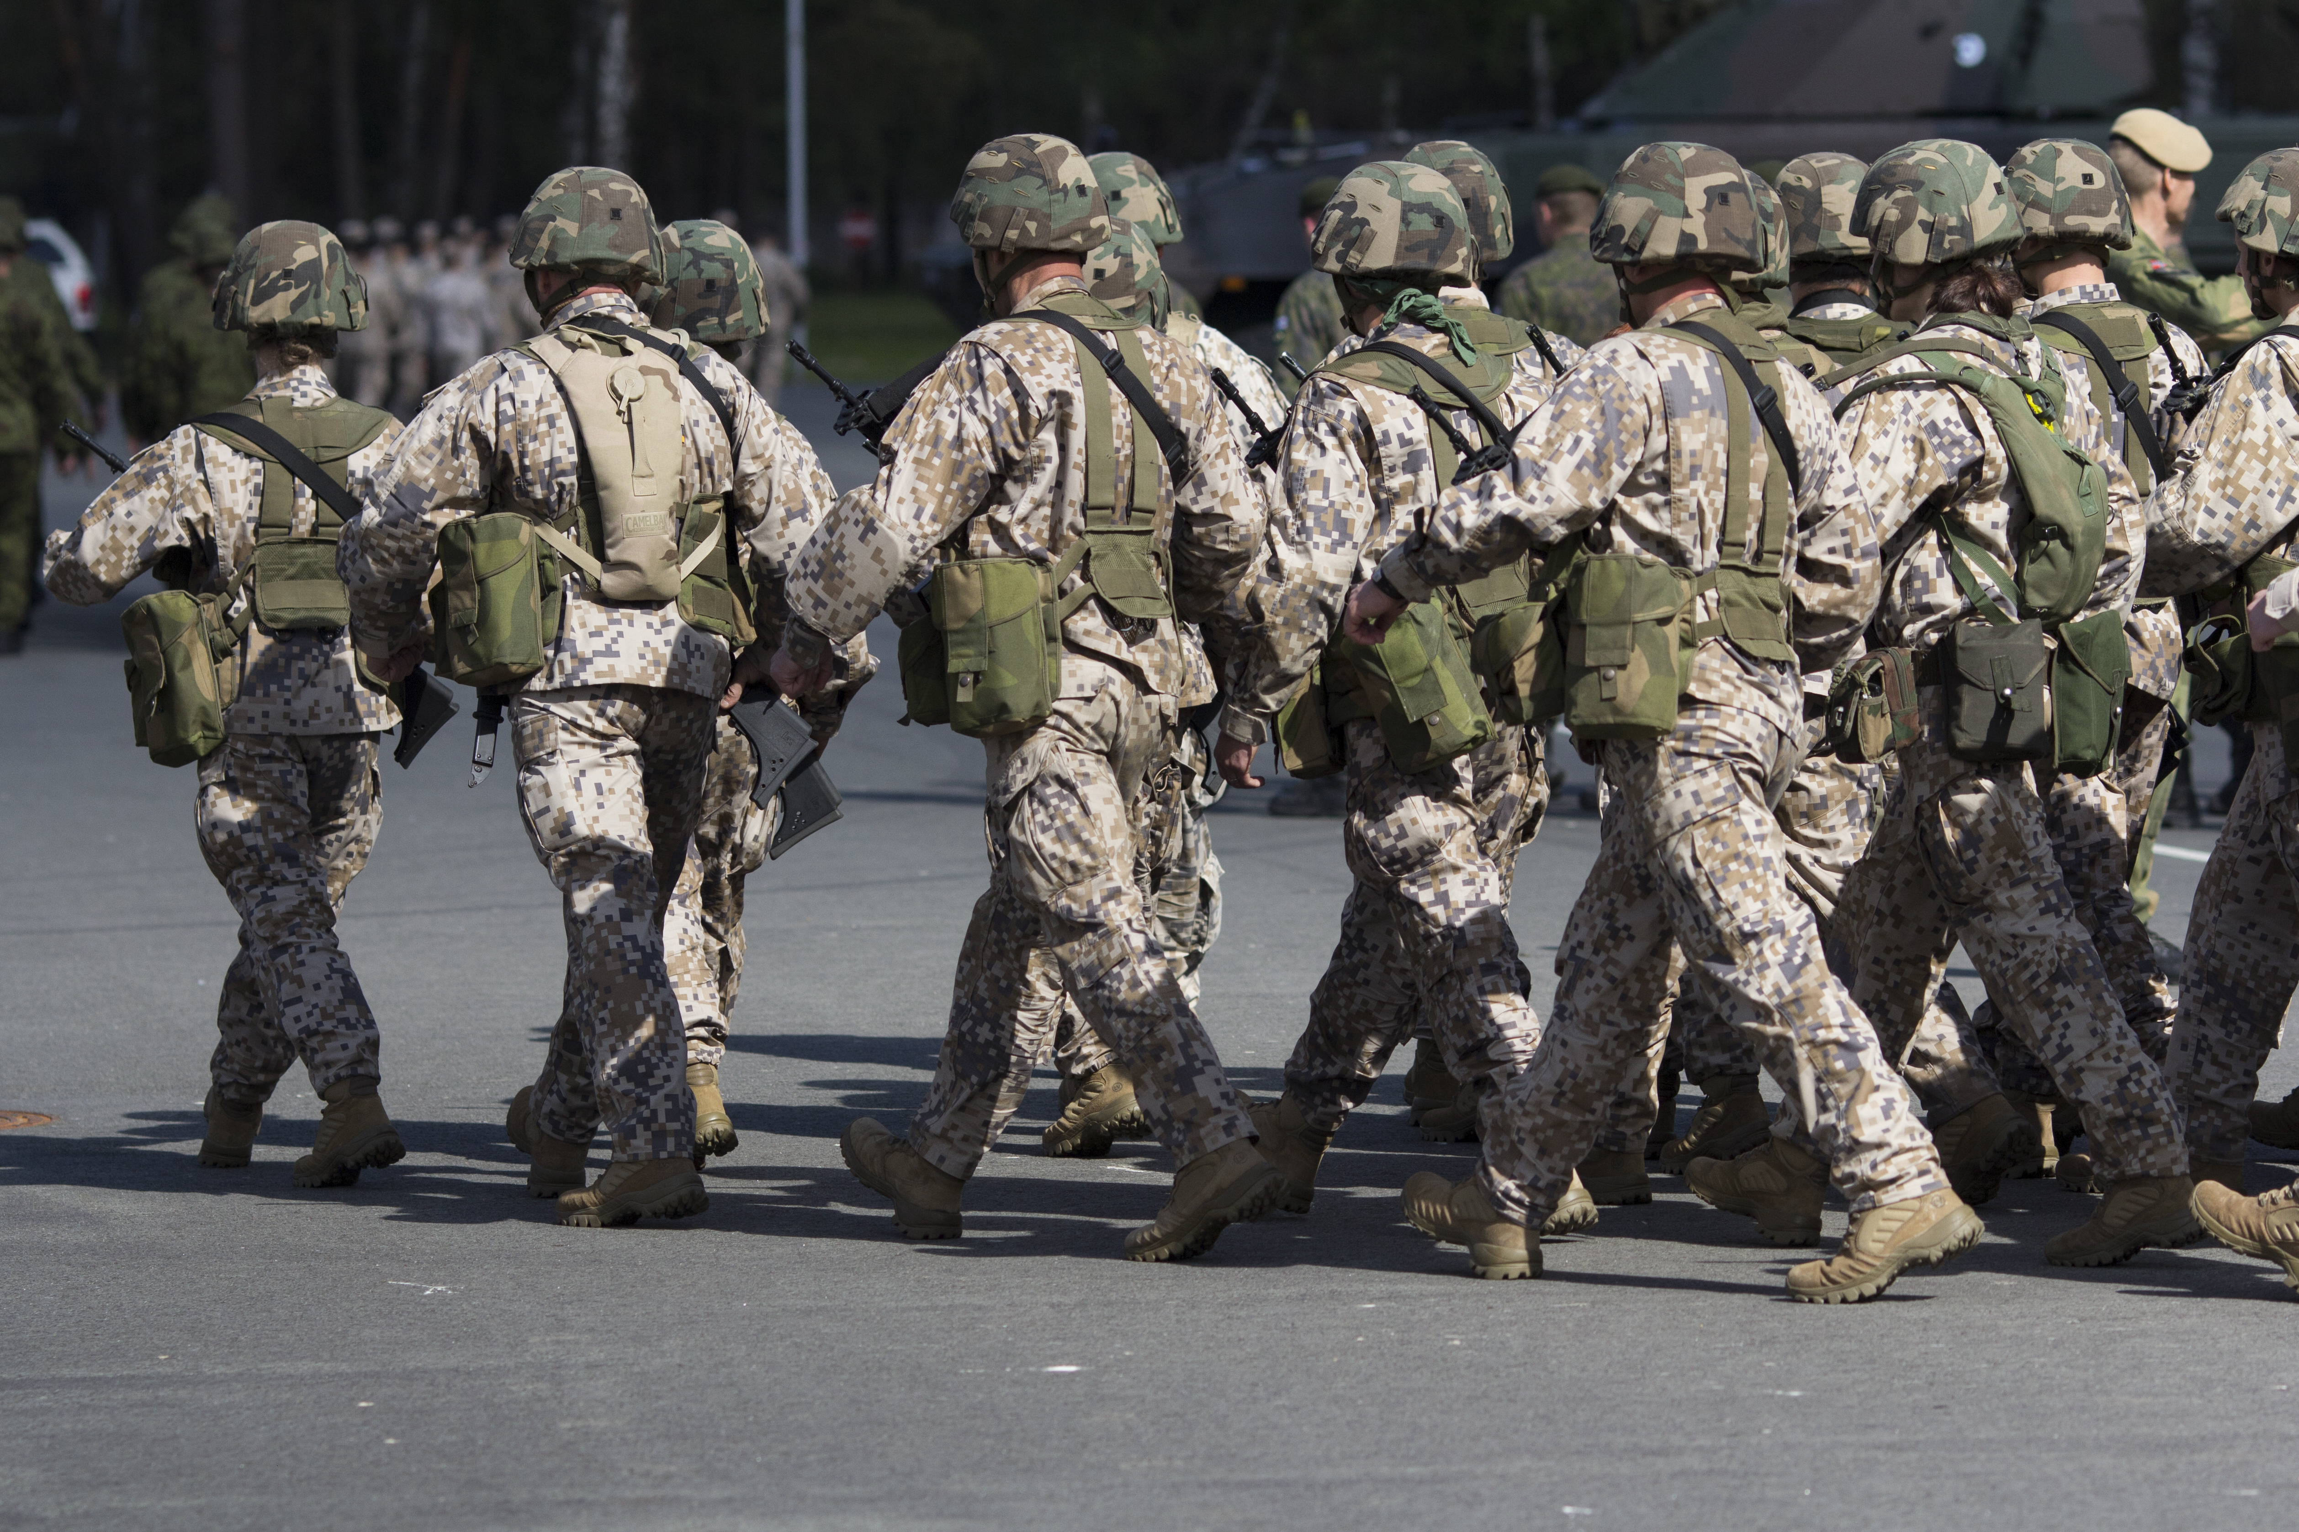
US troops in Afghanistan

Slide 8
Nation Building
“We are pursuing long-term victory in the war by promoting democracy in the Middle East, so that the nations of that region no longer breed hatred and terror.”
“We have also got an ideology based upon liberty which stands in stark contrast to the ideology of the thugs and murderers called the Taliban.” (G.W. Bush)

Slide 9
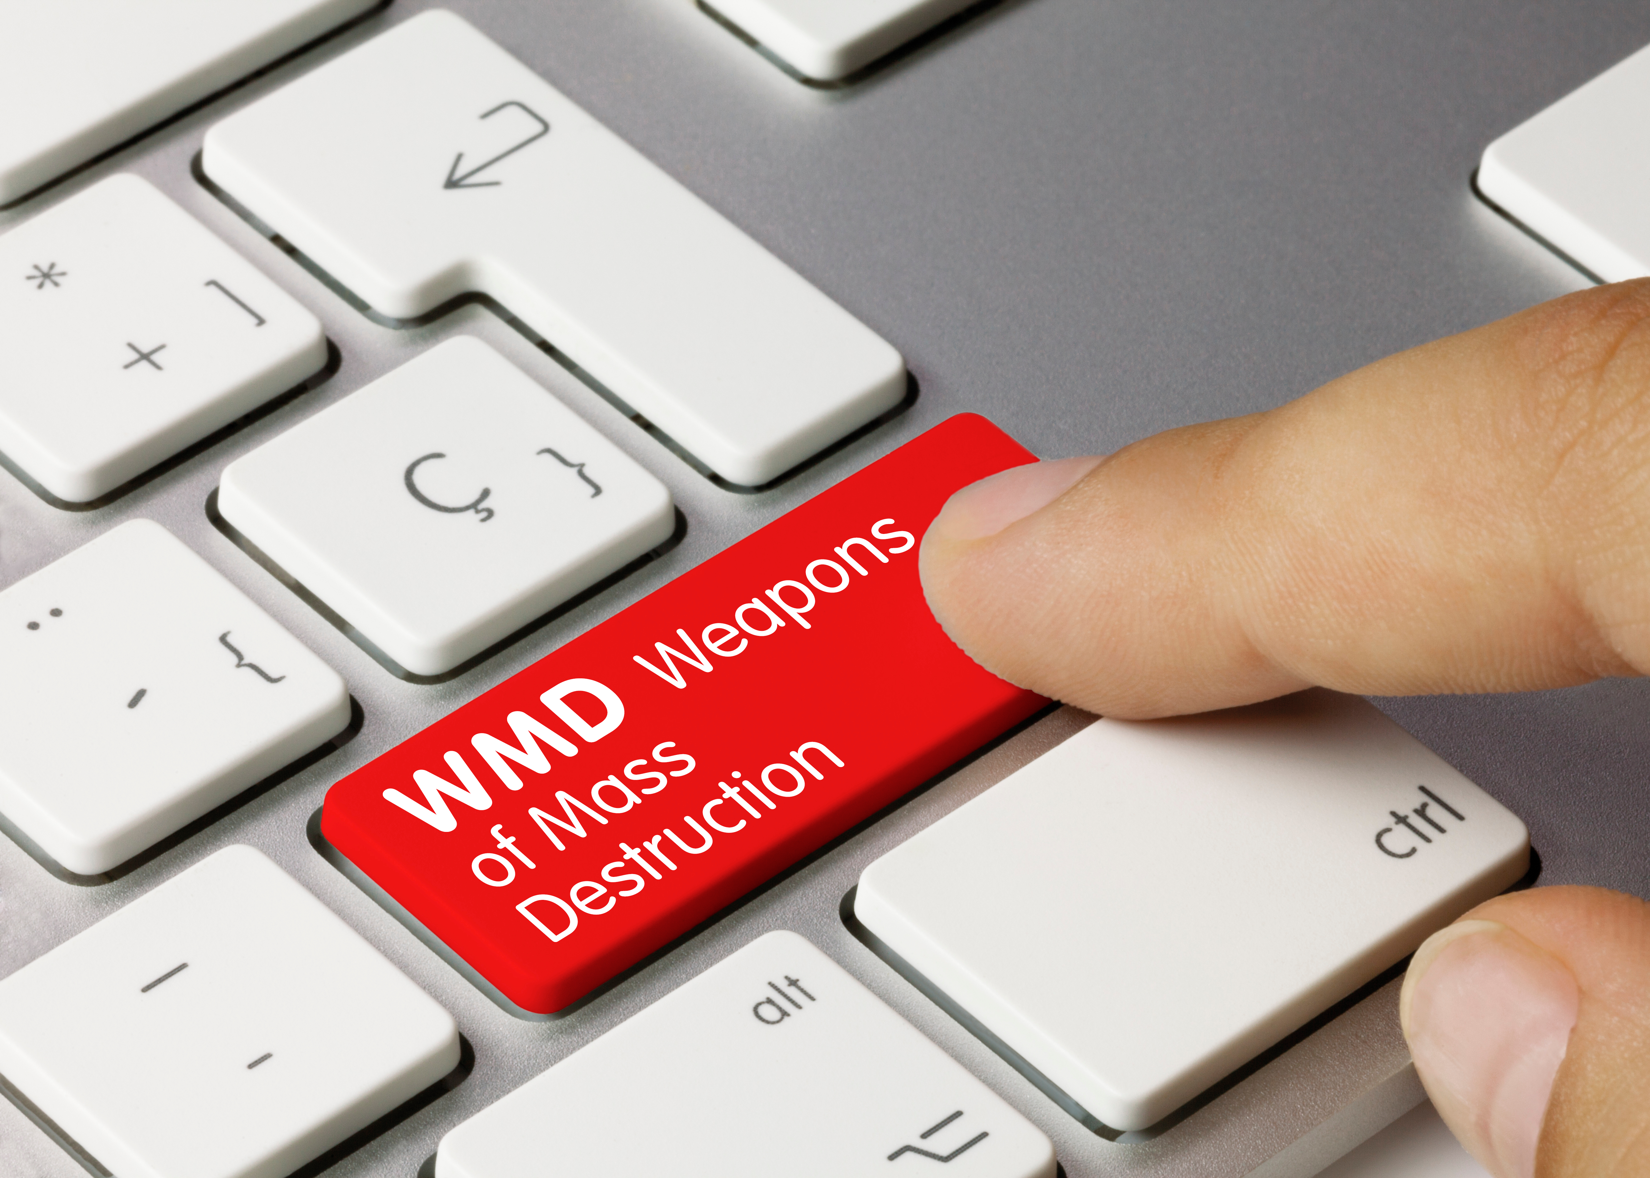
Iraq, WMDs and Saddam Hussein

Slide 10
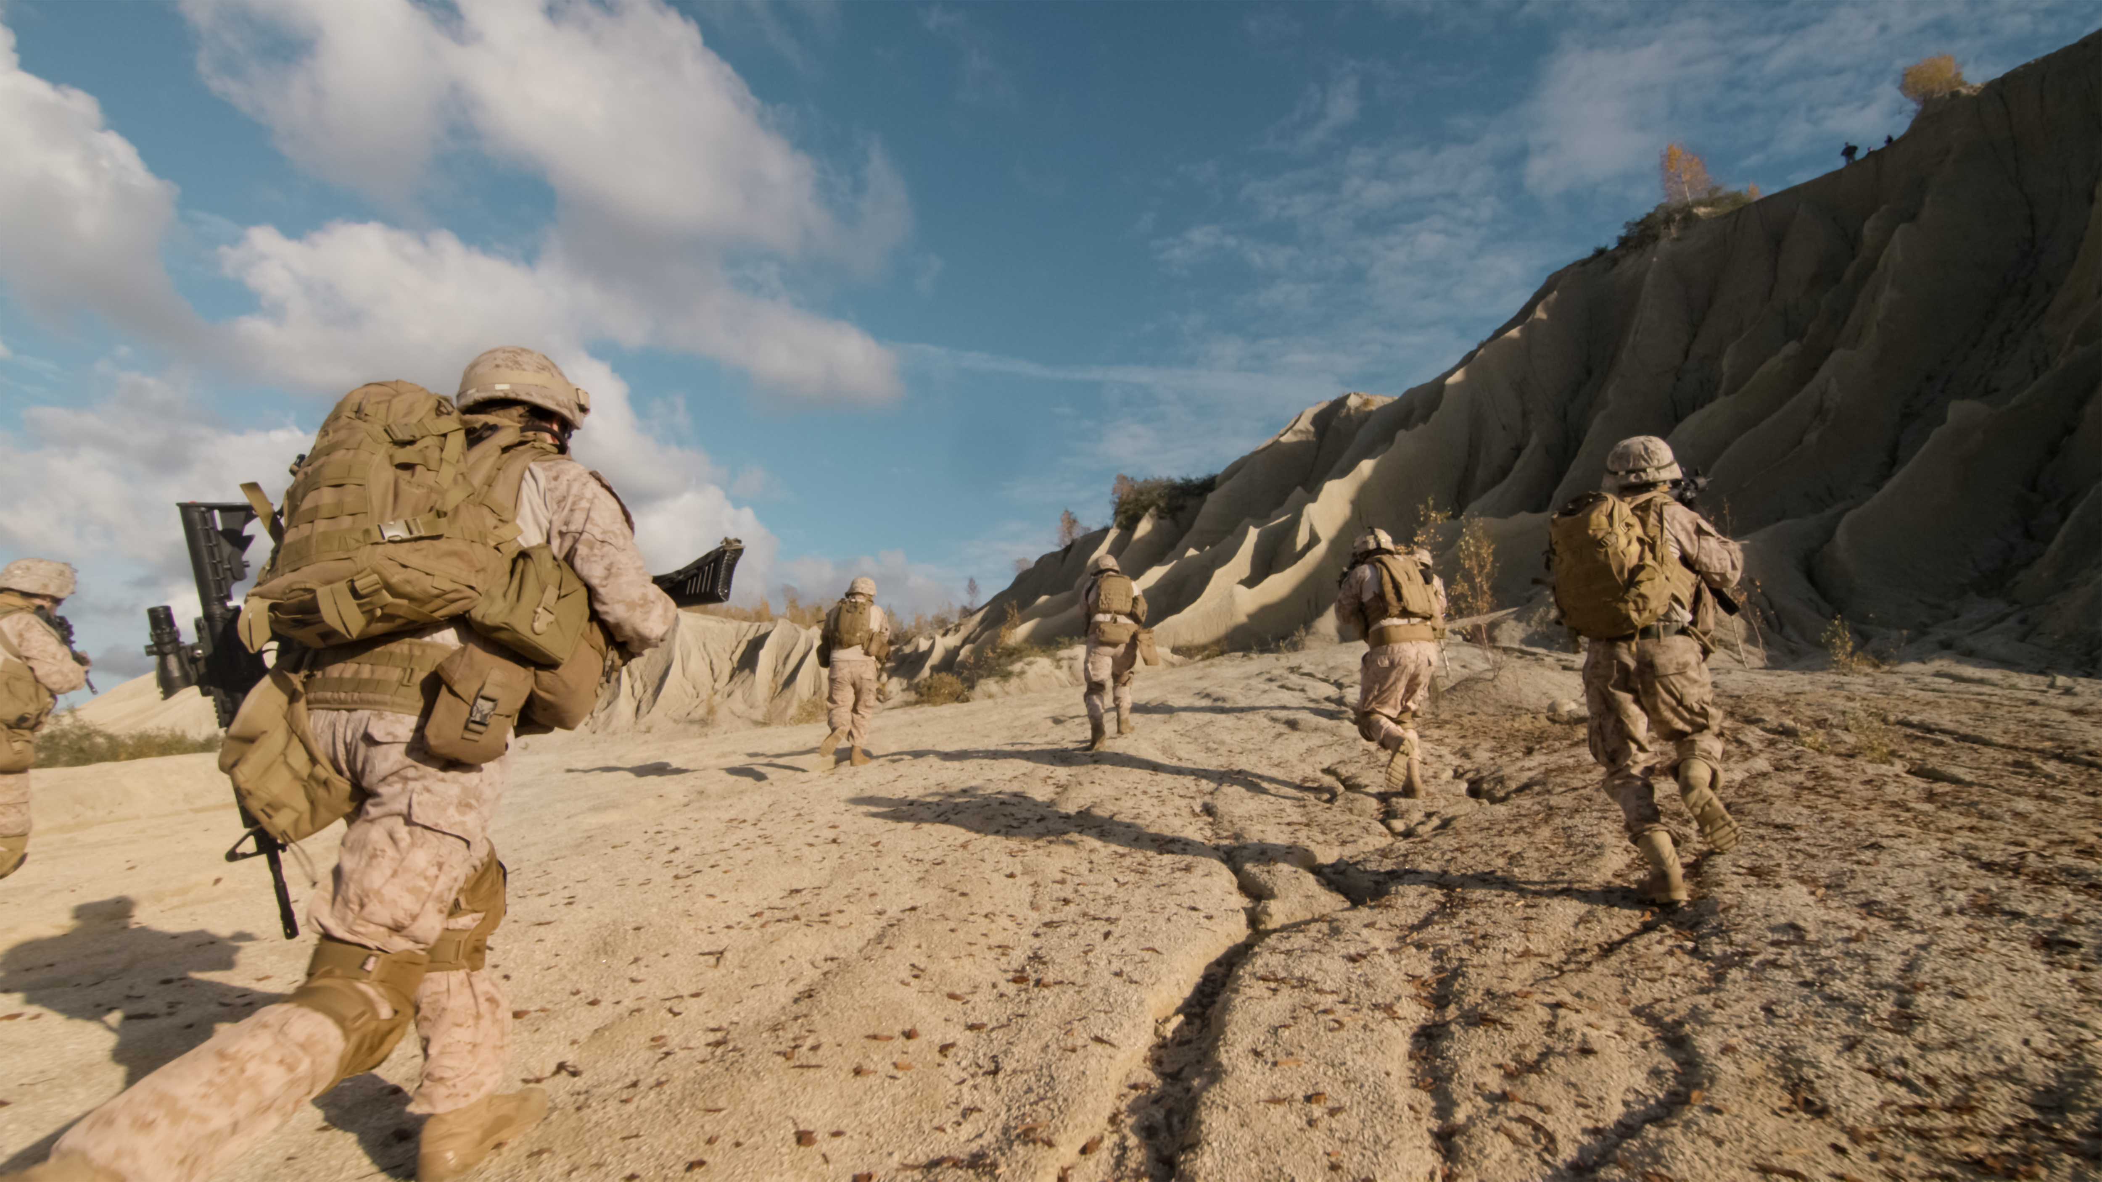
US-led forces invade Iraq - 2003

Slide 11
Shifted expectations
“Our goal is to destroy al-Qaeda, and we are on a path to do exactly that.”
“Afghans are responsible for the security of their nation, and we build an equal partnership between two sovereign states; a future in which war ends and a new chapter begins.”

Slide 12
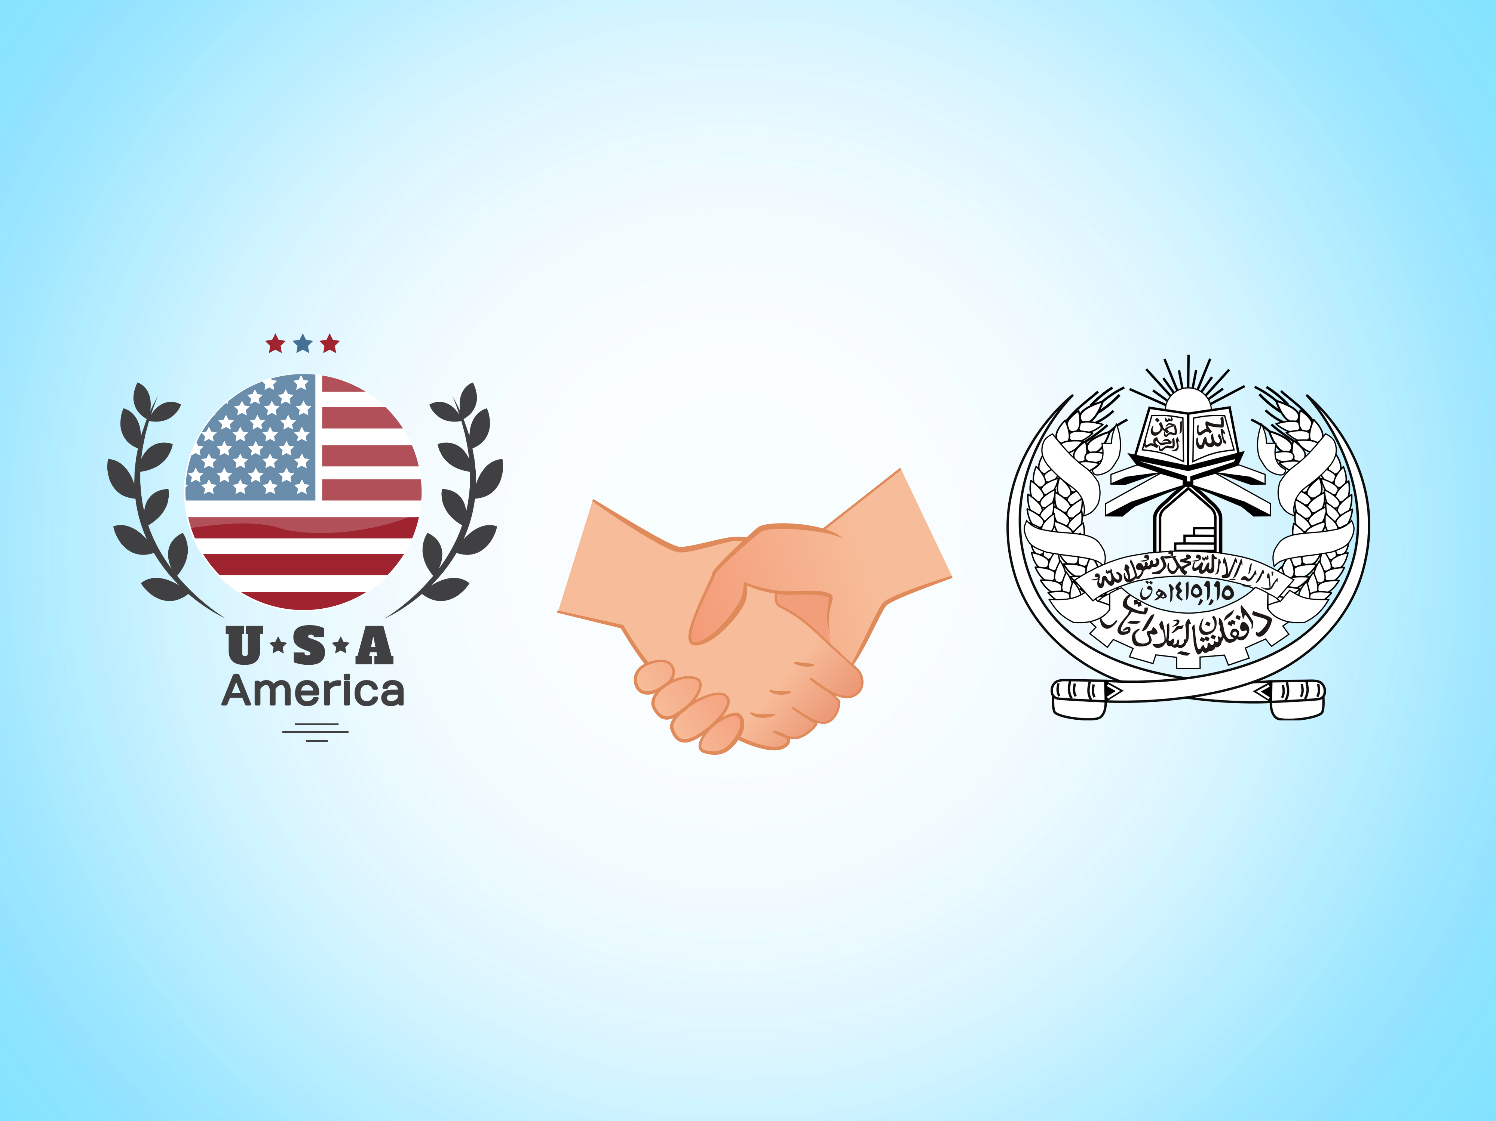
US and Taliban sign agreement in Doha. 2020

Slide 13
Planning withdrawal
“There hasn’t been a moment like this. We’ve had very successful negotiations. We think they’ll be successful in the end.”
“We are not nation-building again. We are killing terrorists.”

Slide 14
Rapid conclusion (chaos)
“I cannot and will not ask our troops to fight on endlessly in another country’s civil war.”
“It’s time to end the forever war”

Slide 15
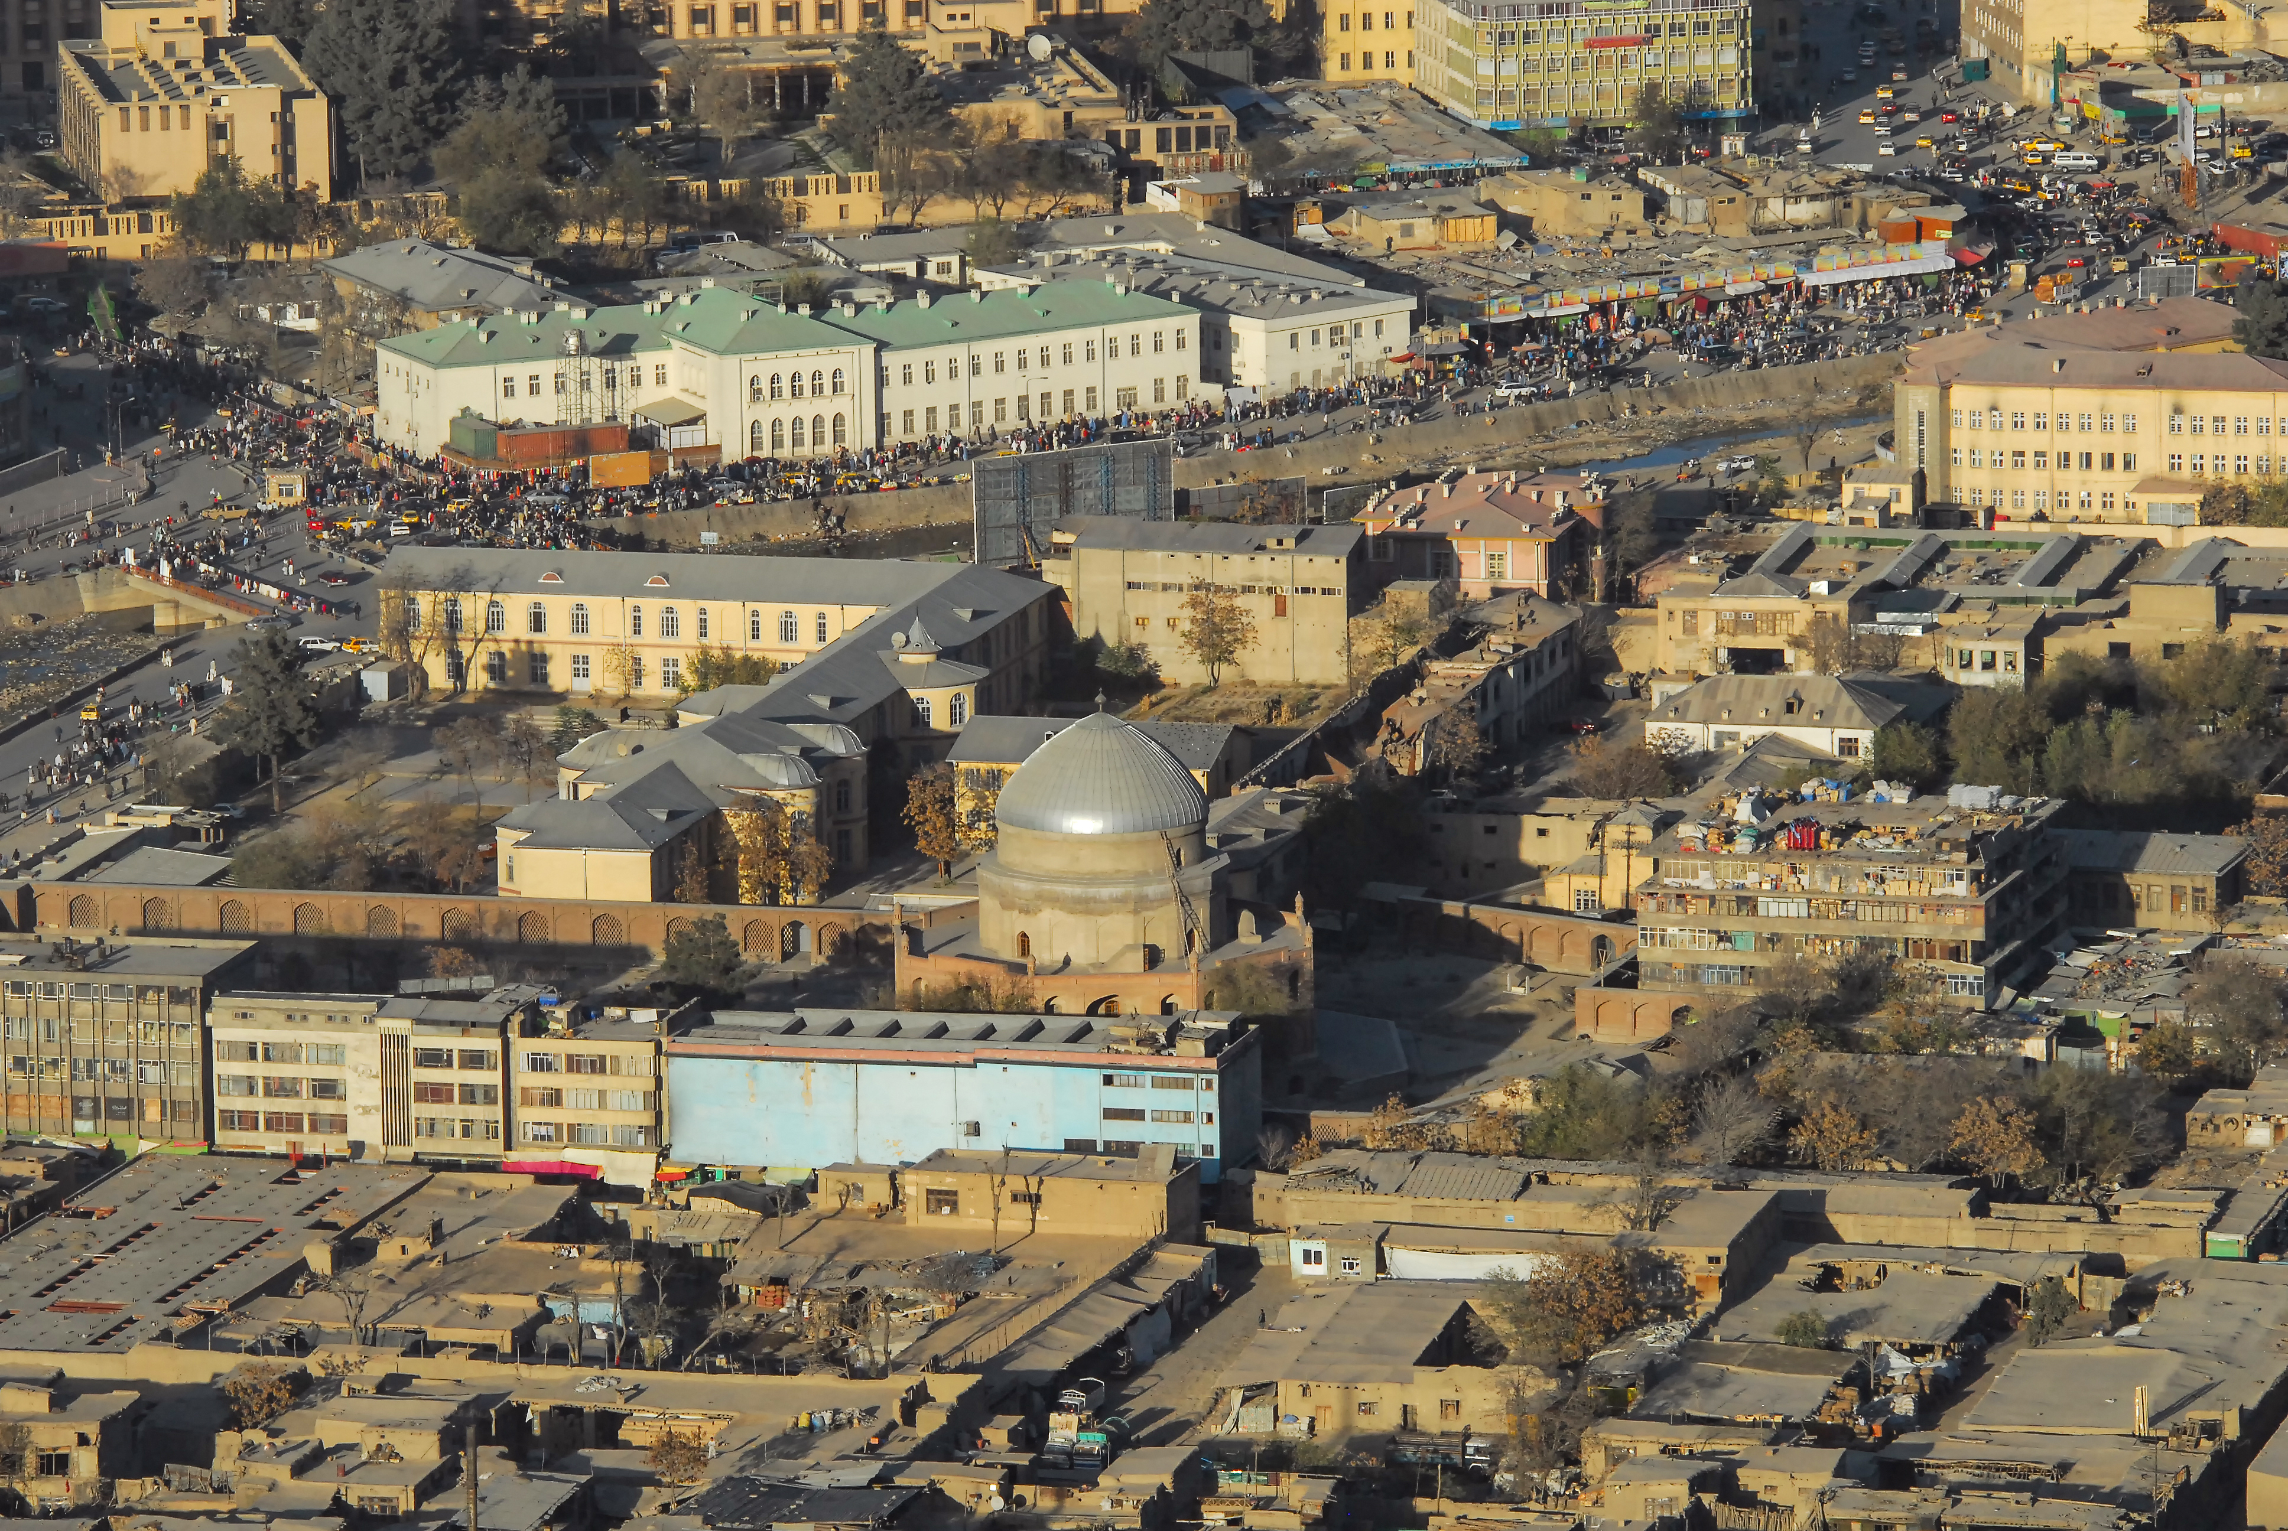
Taliban enter Kabul – 15th August 2021

Slide 16
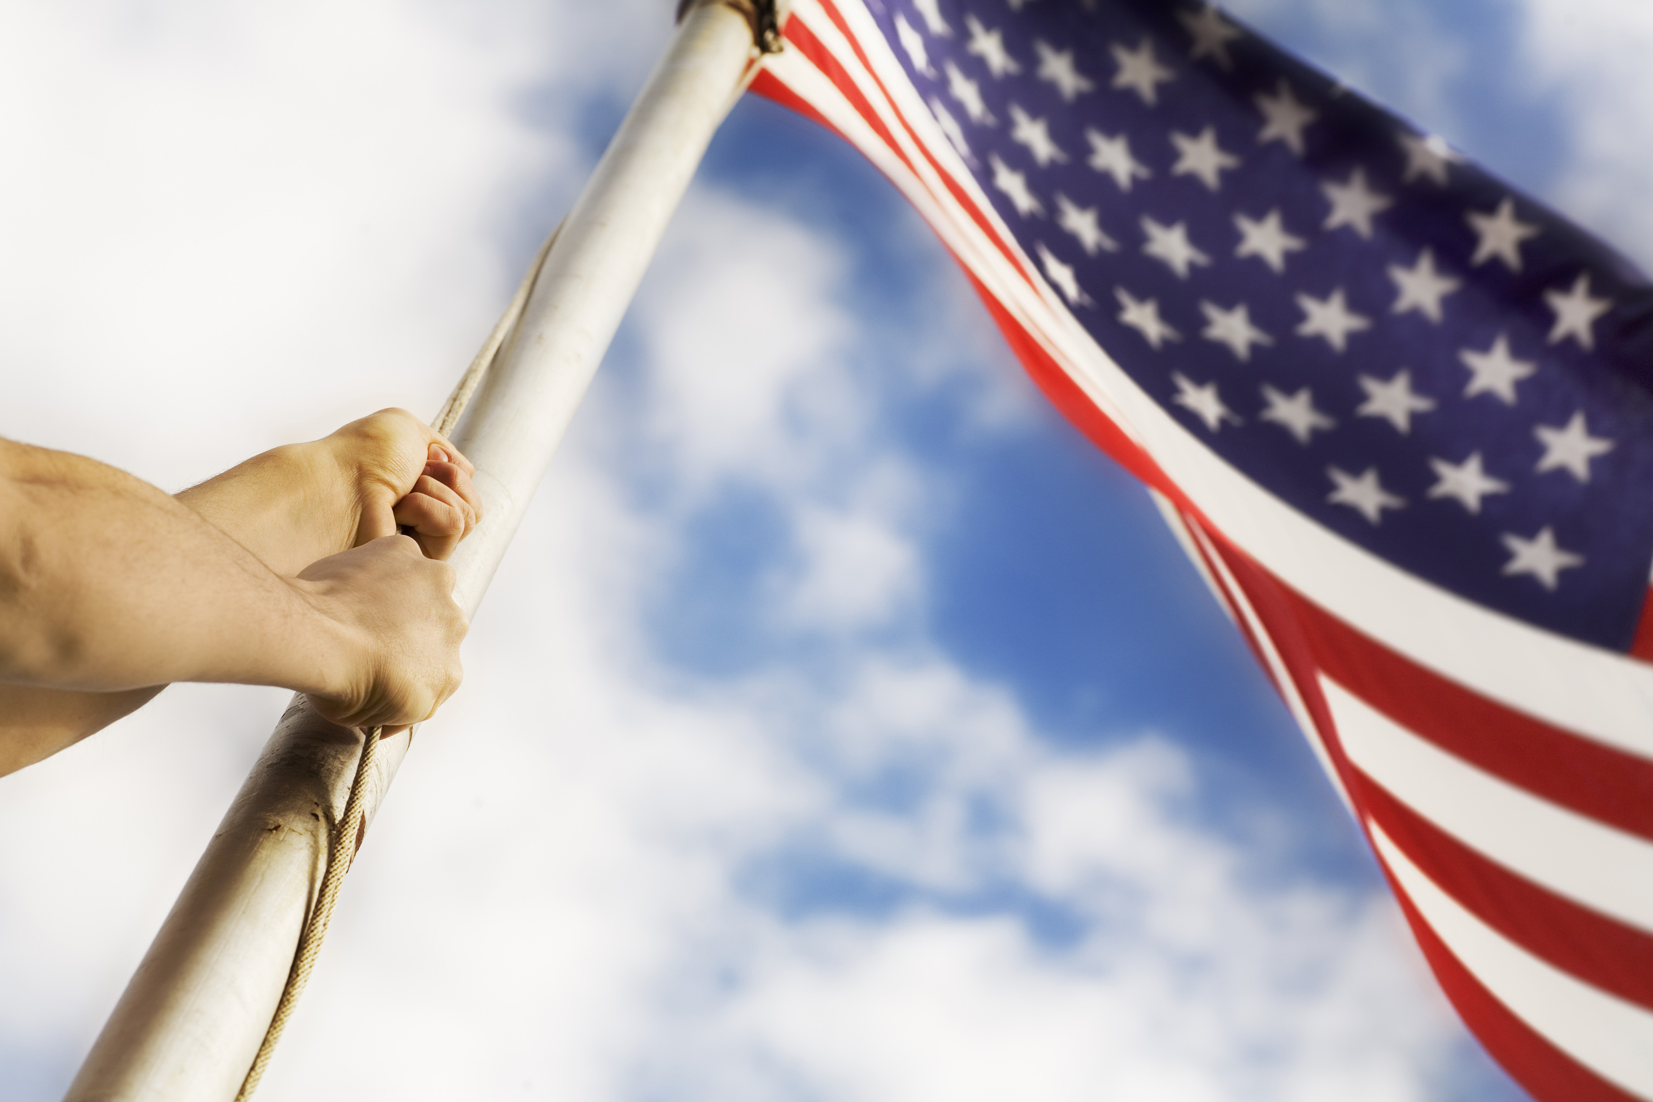
US troops abandon Afghanistan 15-30 August 2021

Slide 17
Flight from Kabul
“The idea that somehow there’s a way to have gotten out without chaos ensuing, I don’t know how that happens.” (Joe Biden)

Slide 18
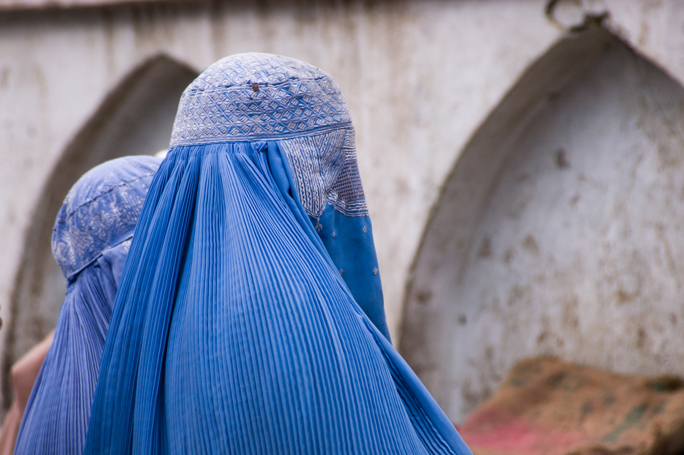
Afghan women judges fear for their lives

Slide 19
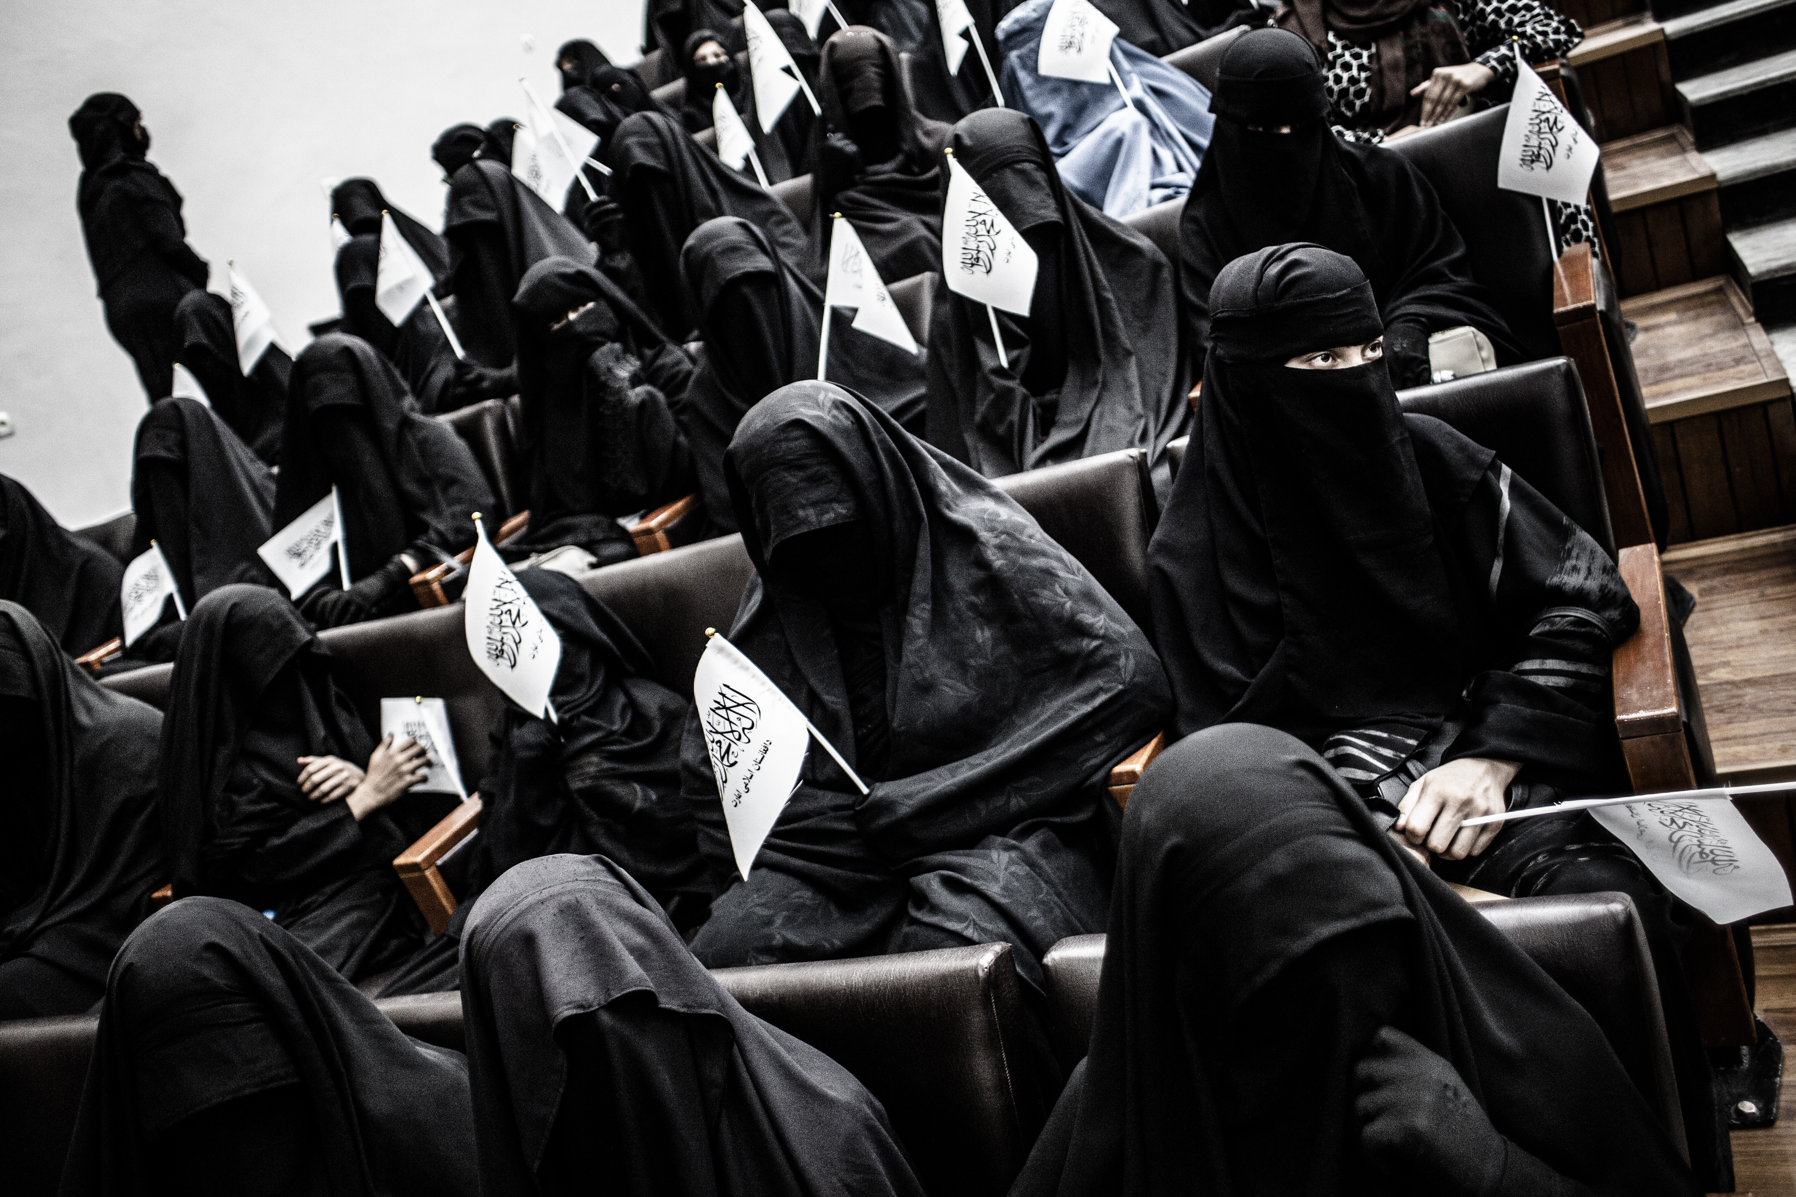
Taliban announce new rules for students

Slide 20
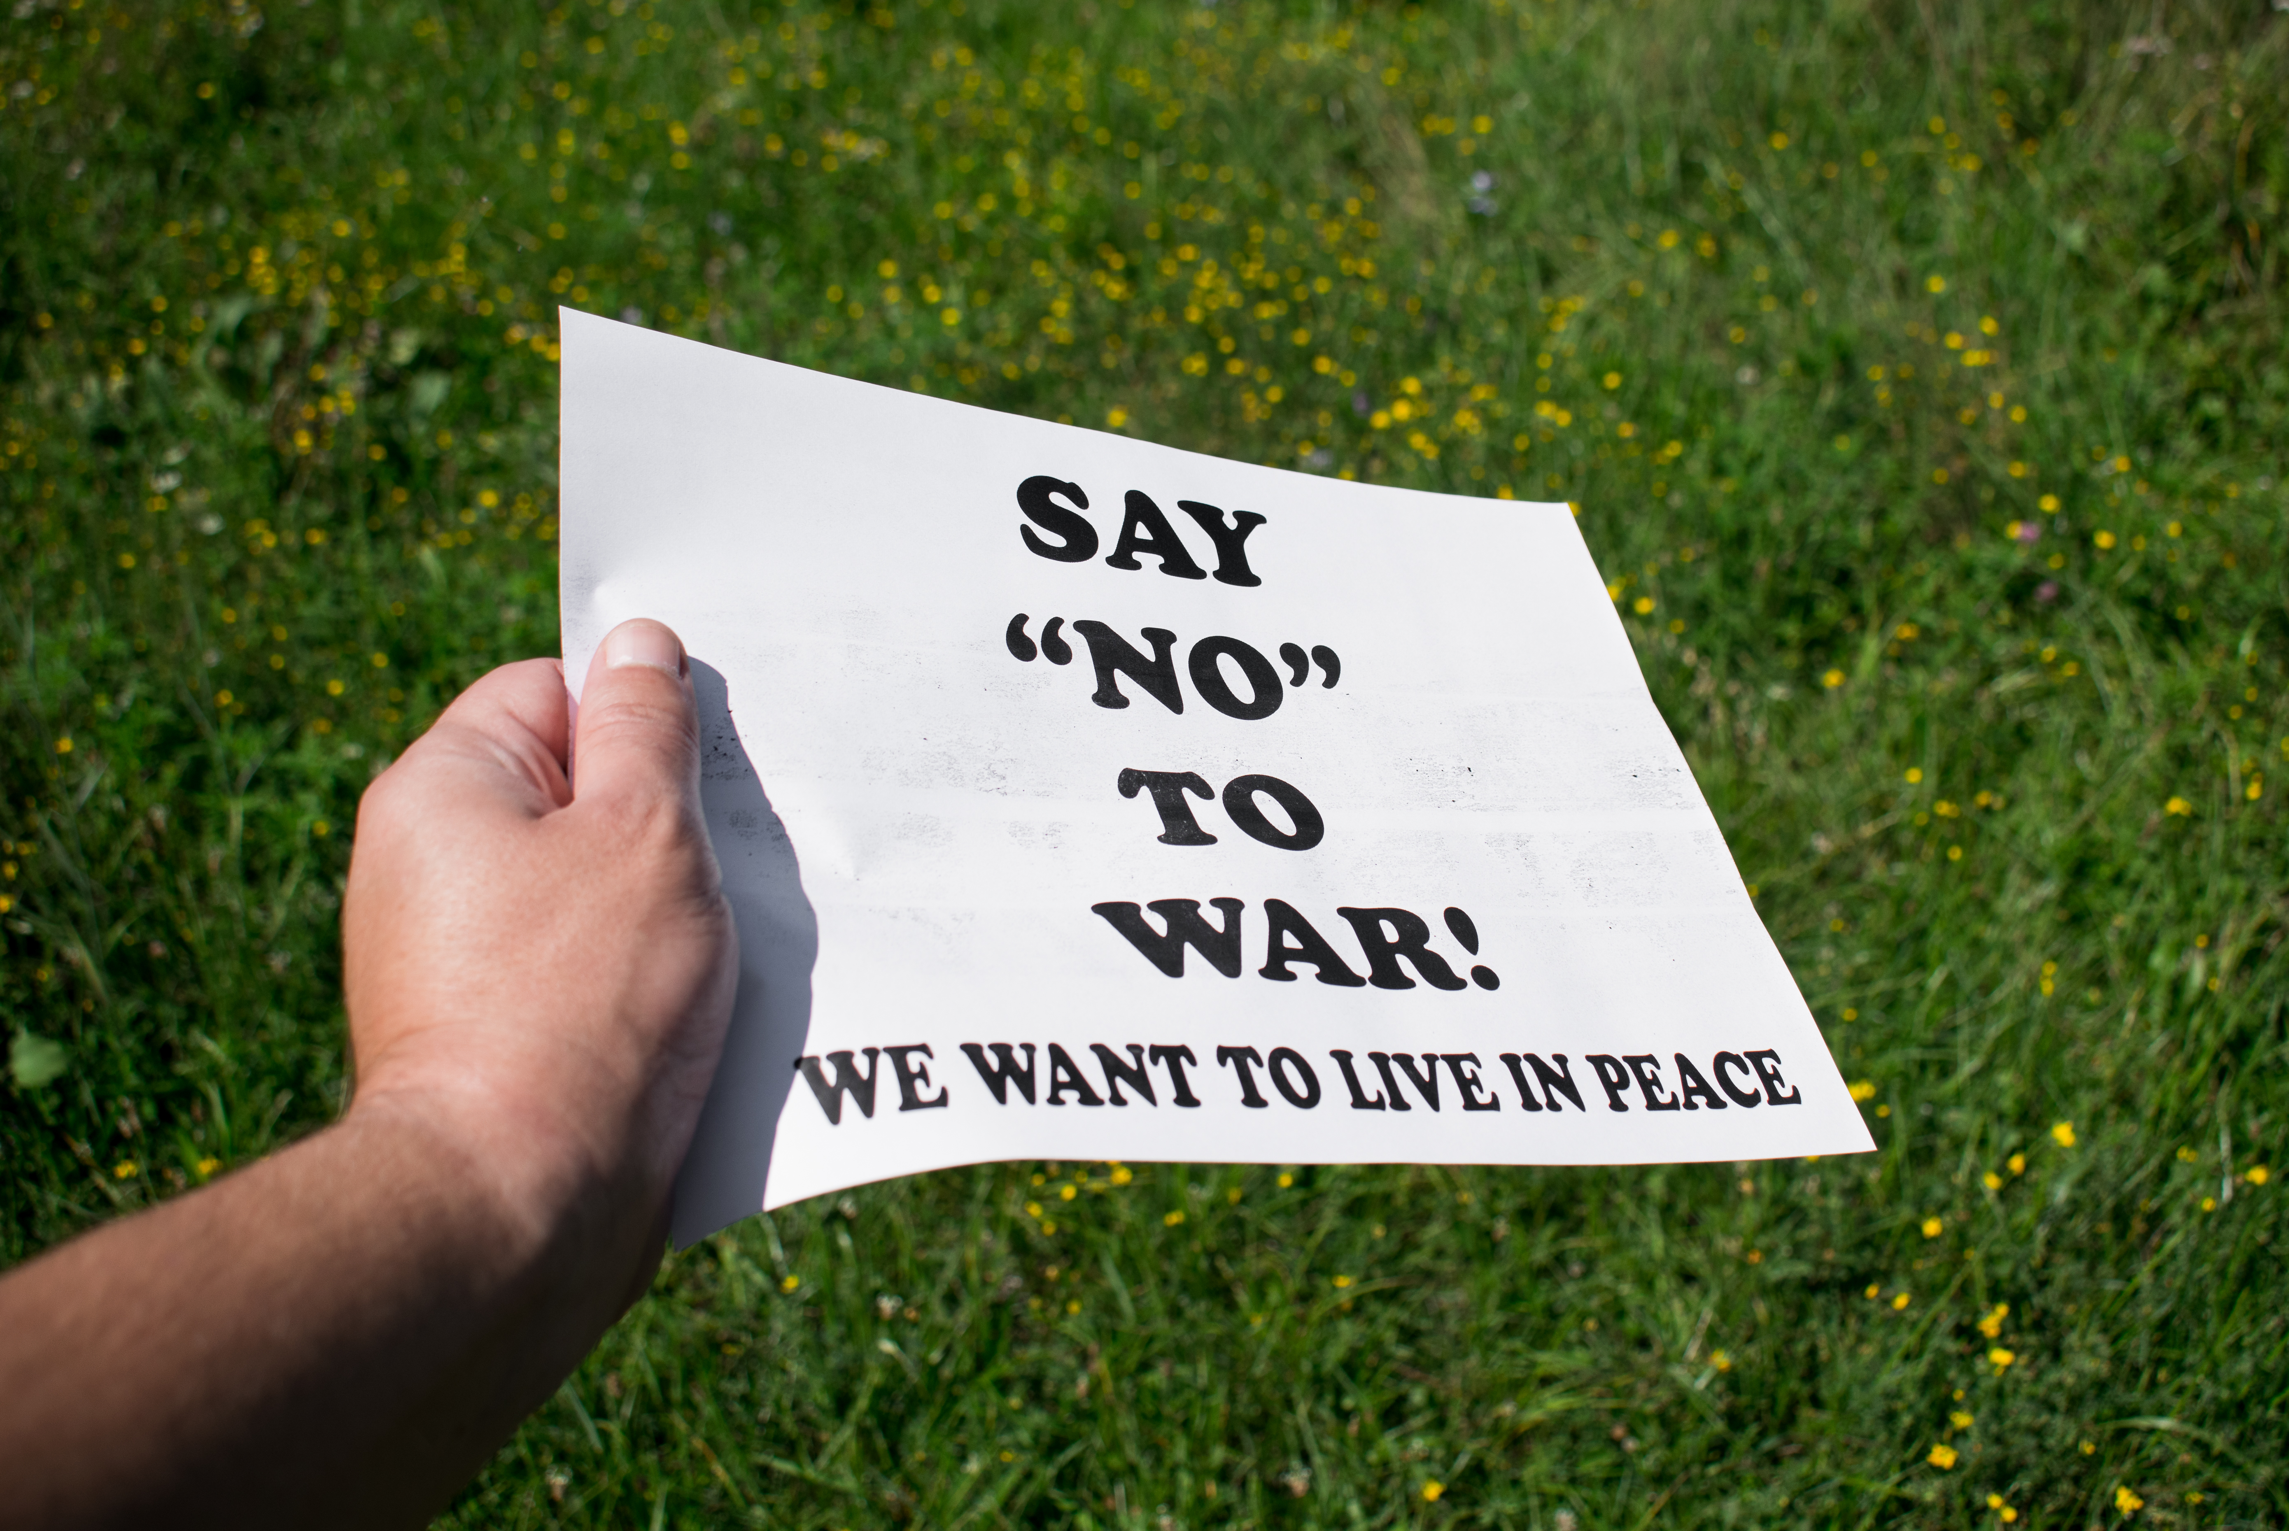
Afghanis protest outside the White House in Washington and in London

