Slide 1
Holocaust Remembrance Day – 27th January

Slide 2
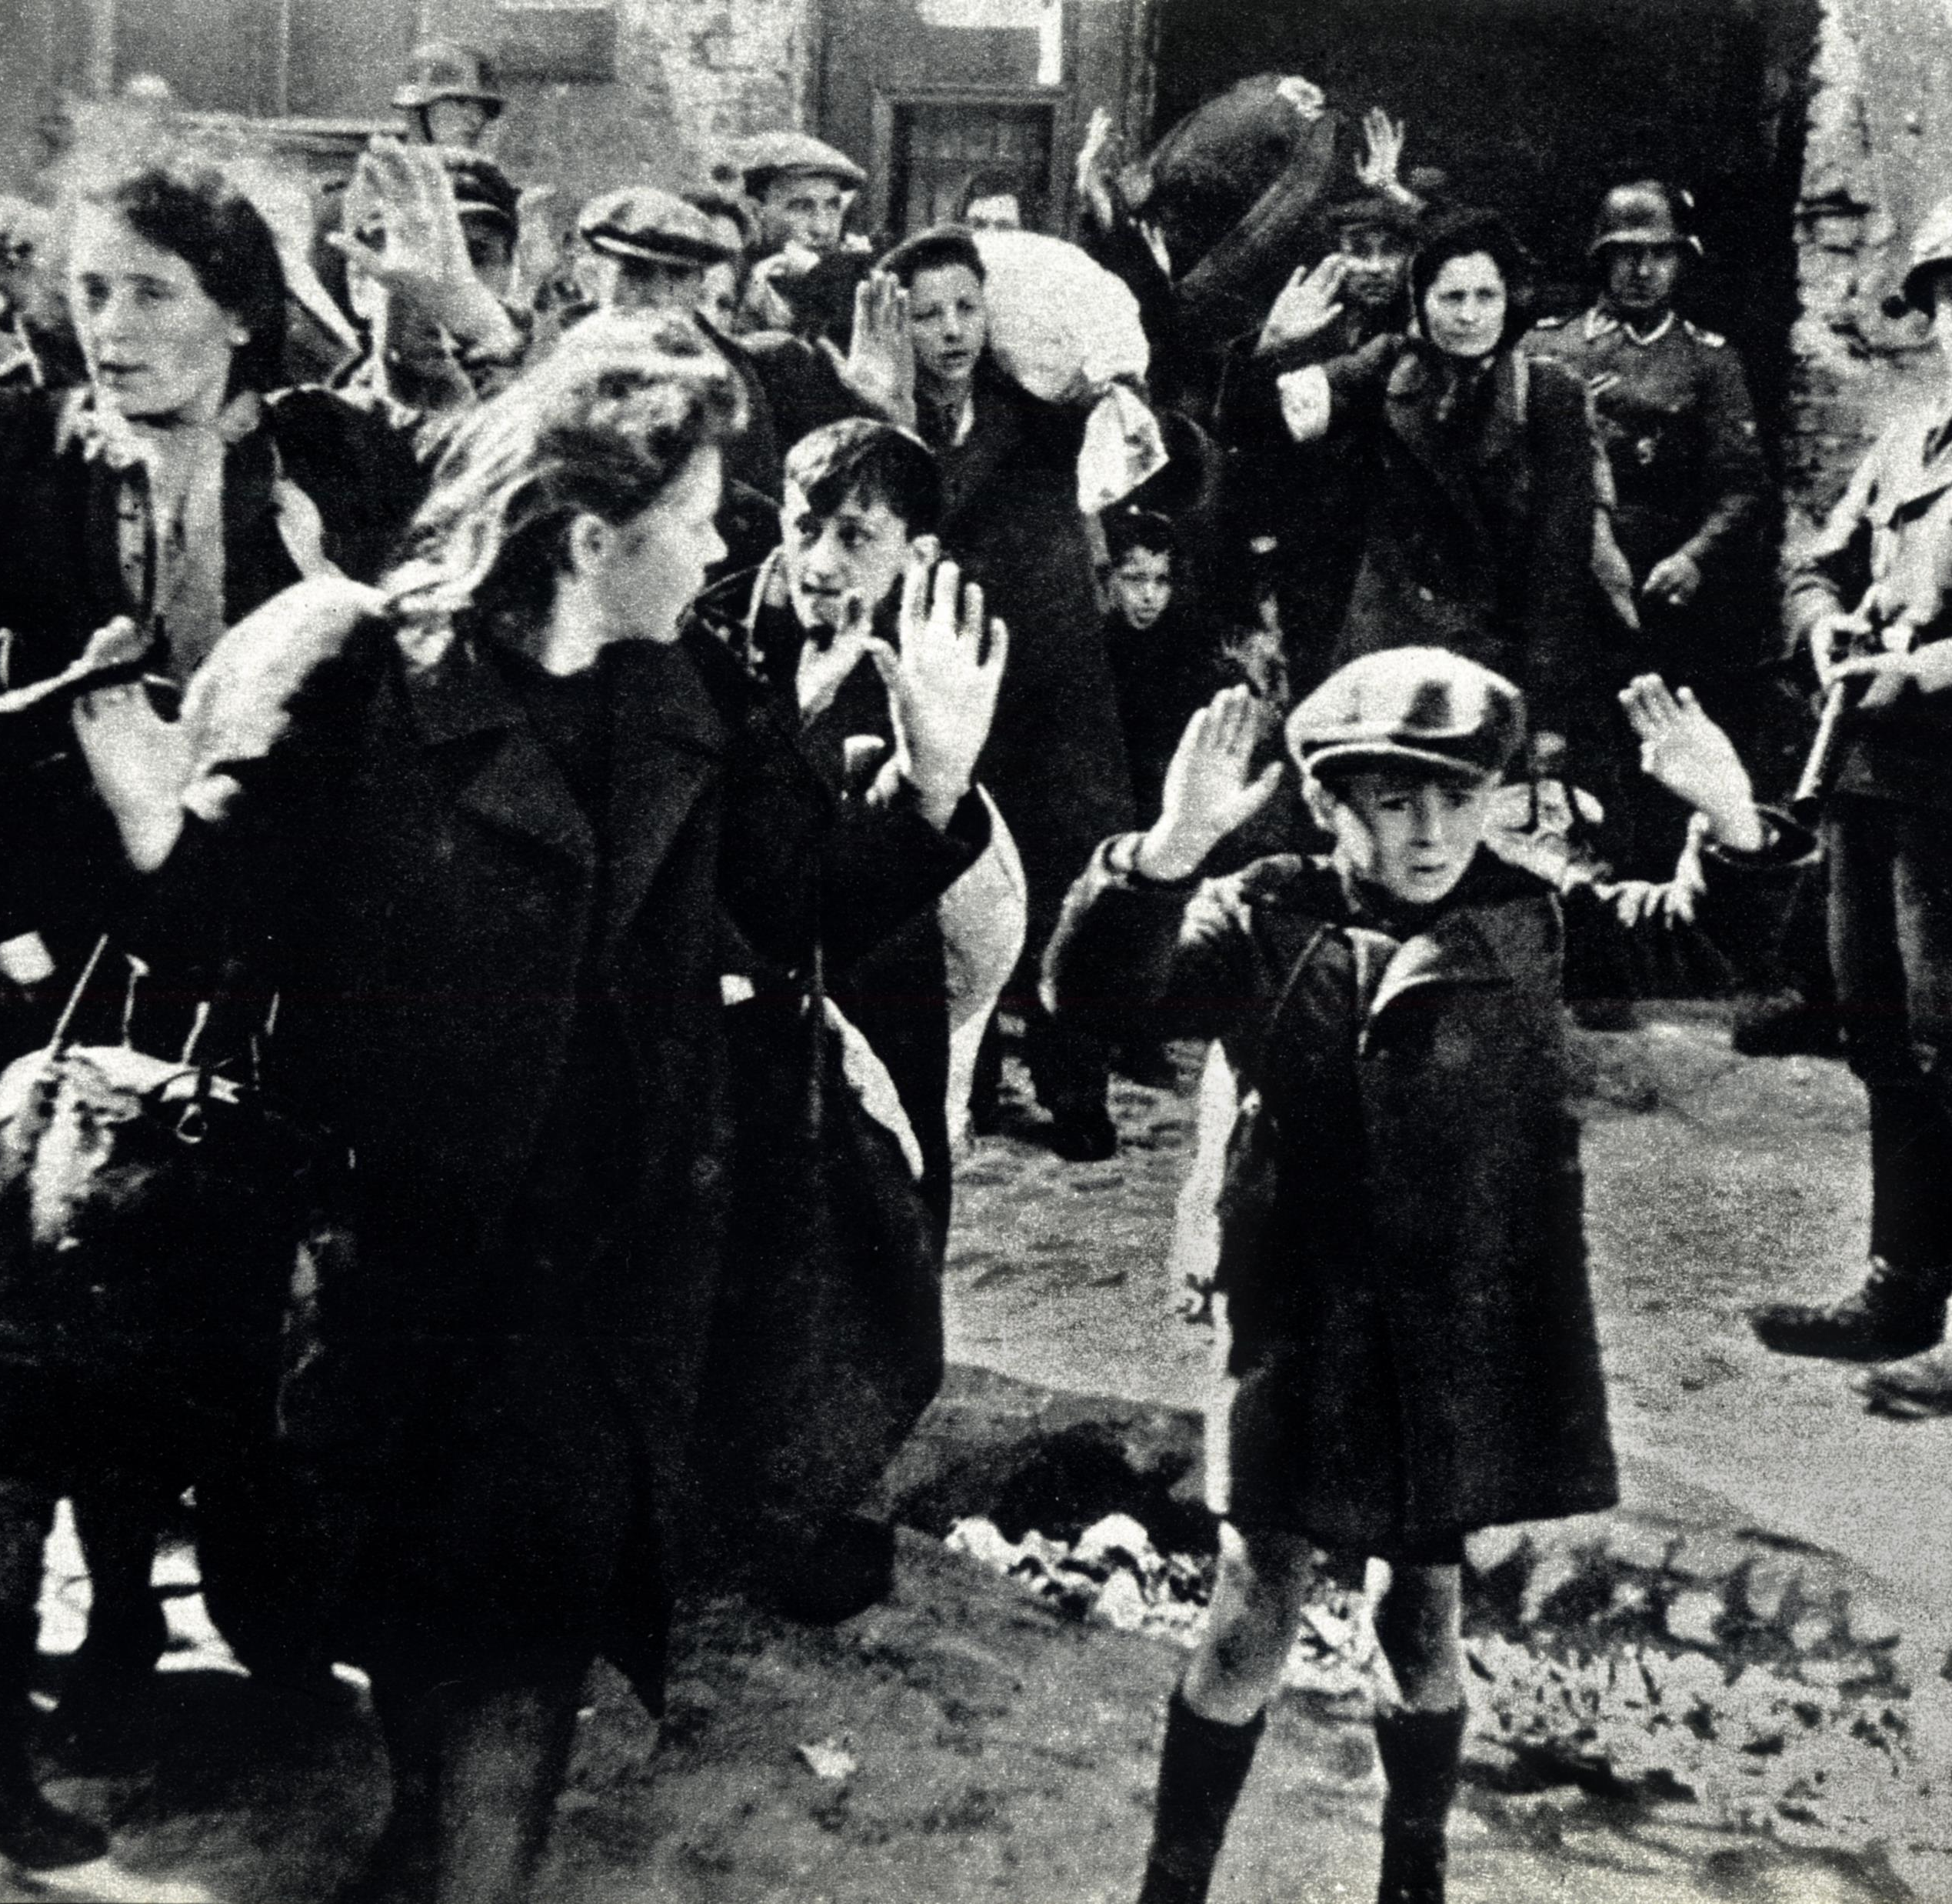
What was the Holocaust?

Slide 3
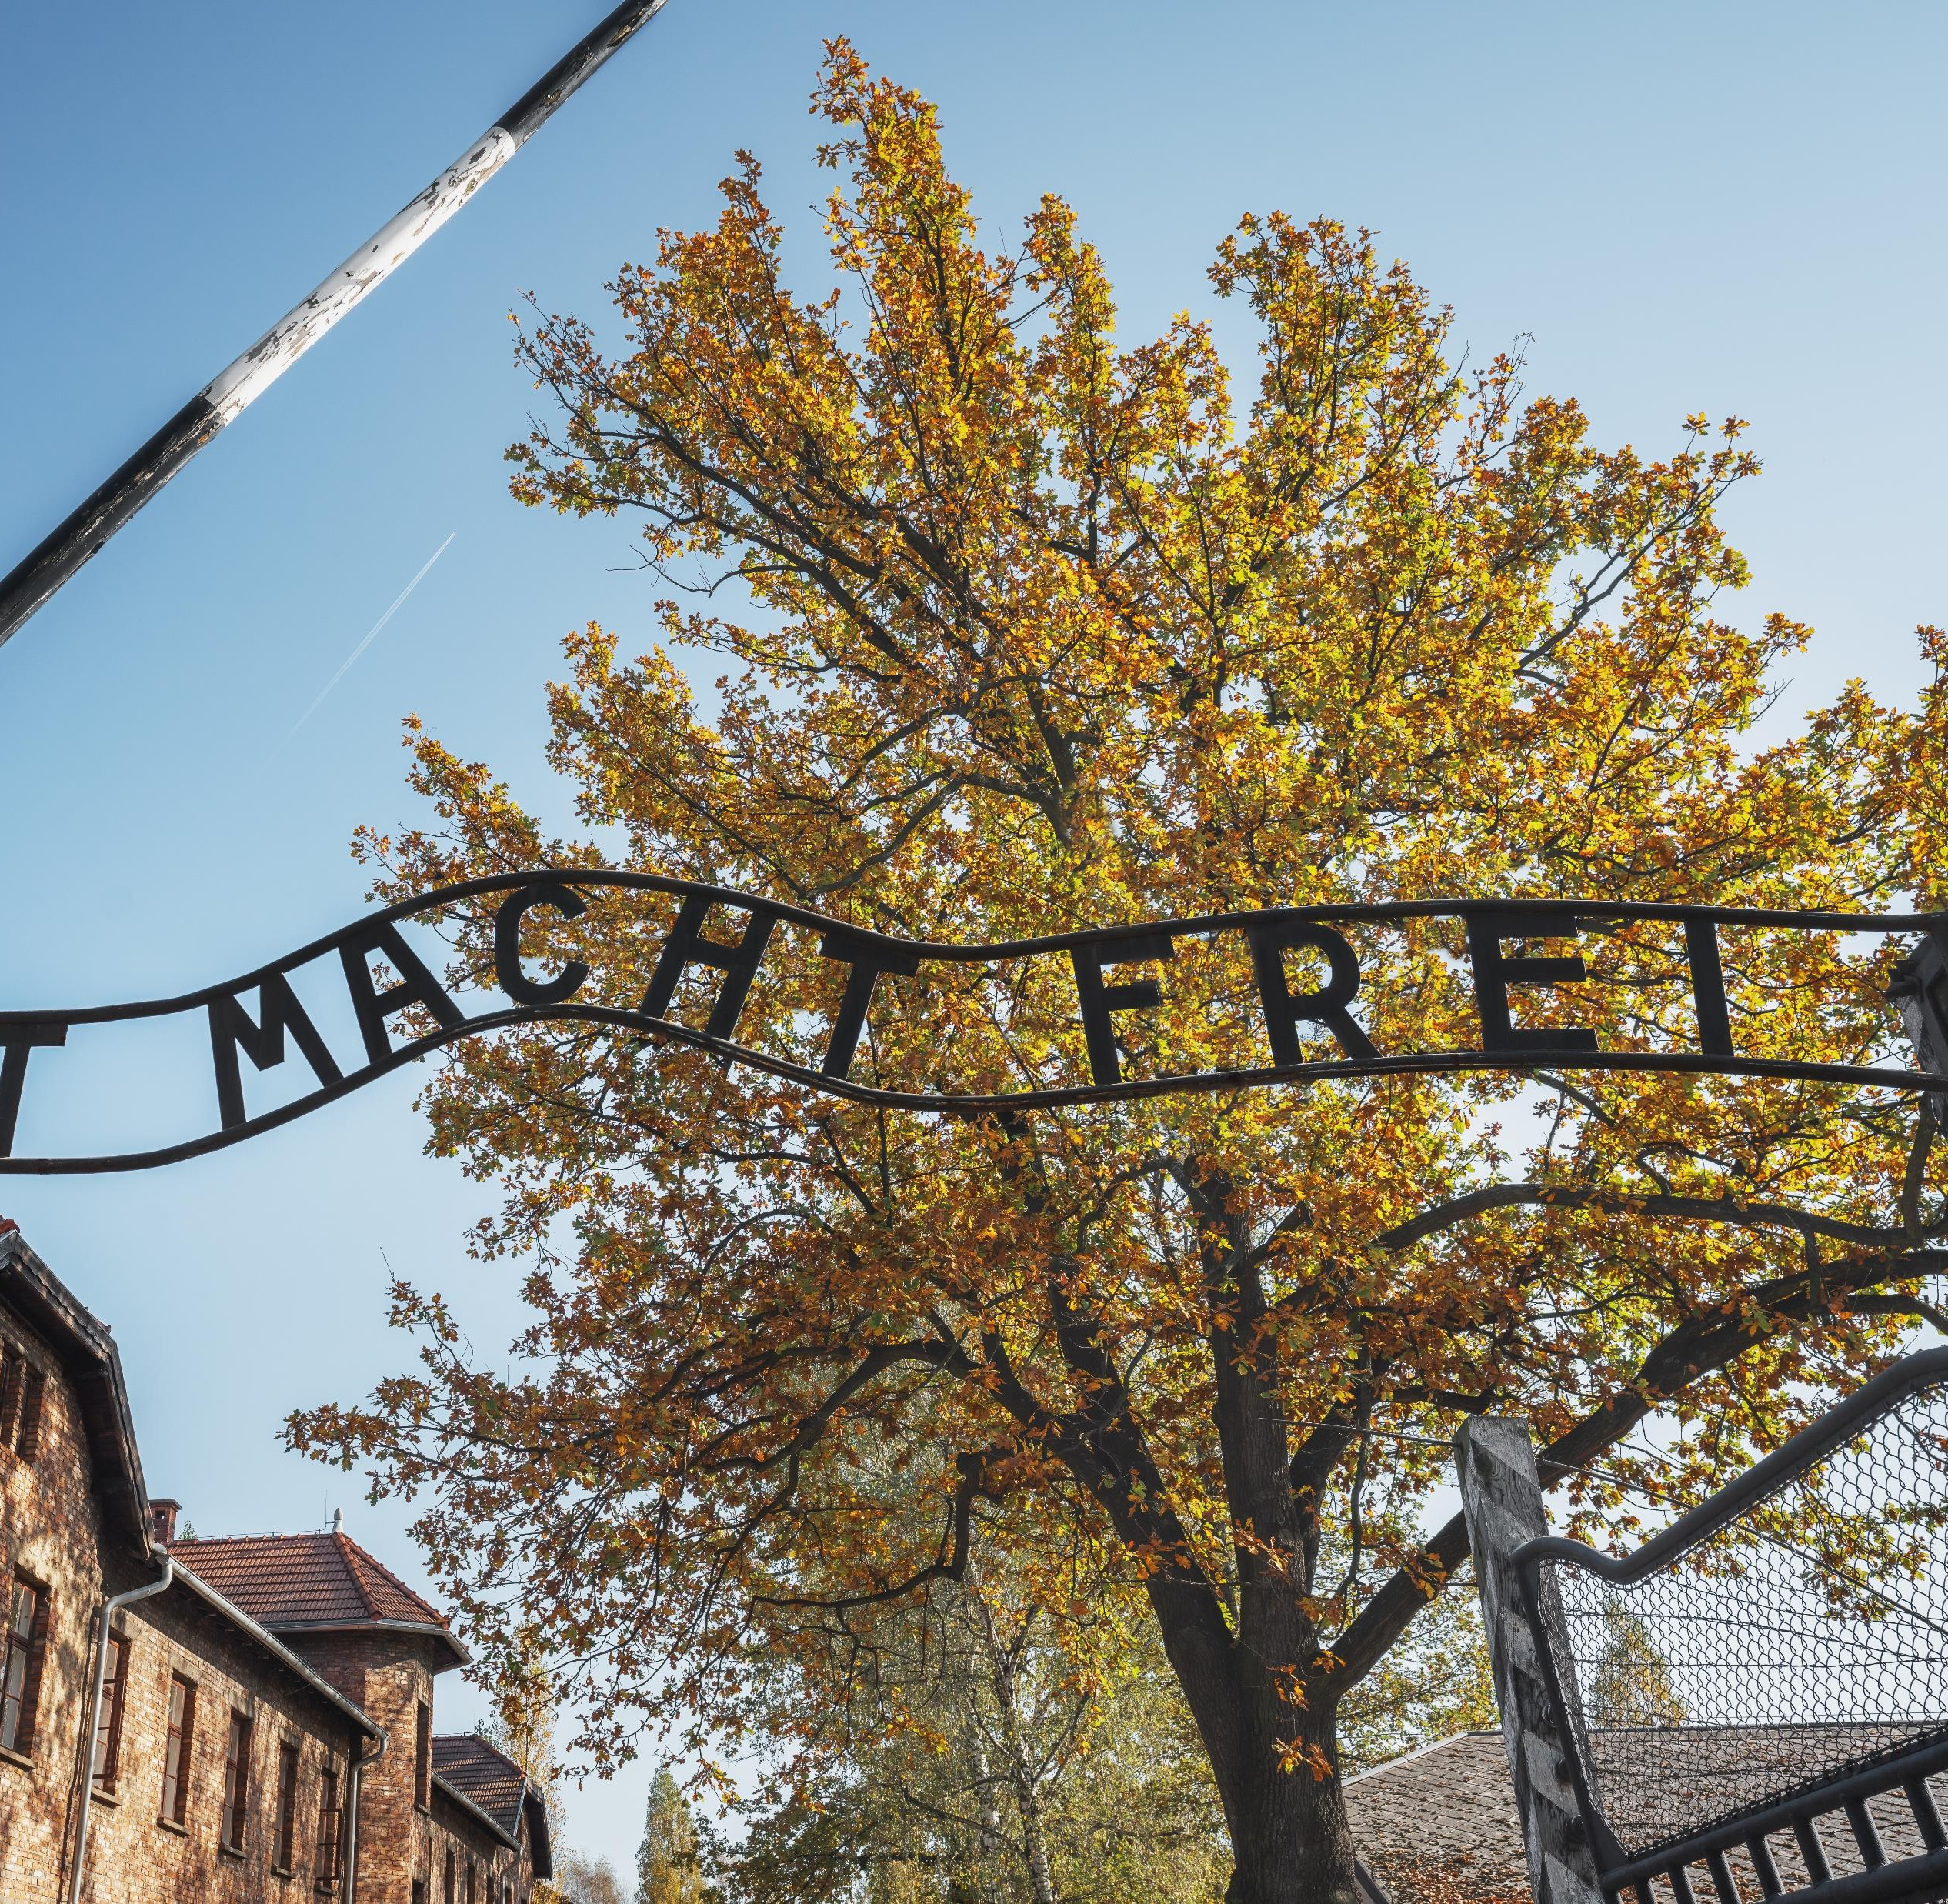
Concentration camps and extermination camps

Slide 4

2005 – WORLD HOLOCAUST REMEMBRANCE DAY

Slide 5

NEVER FORGET
NEVER AGAIN

