Slide 1
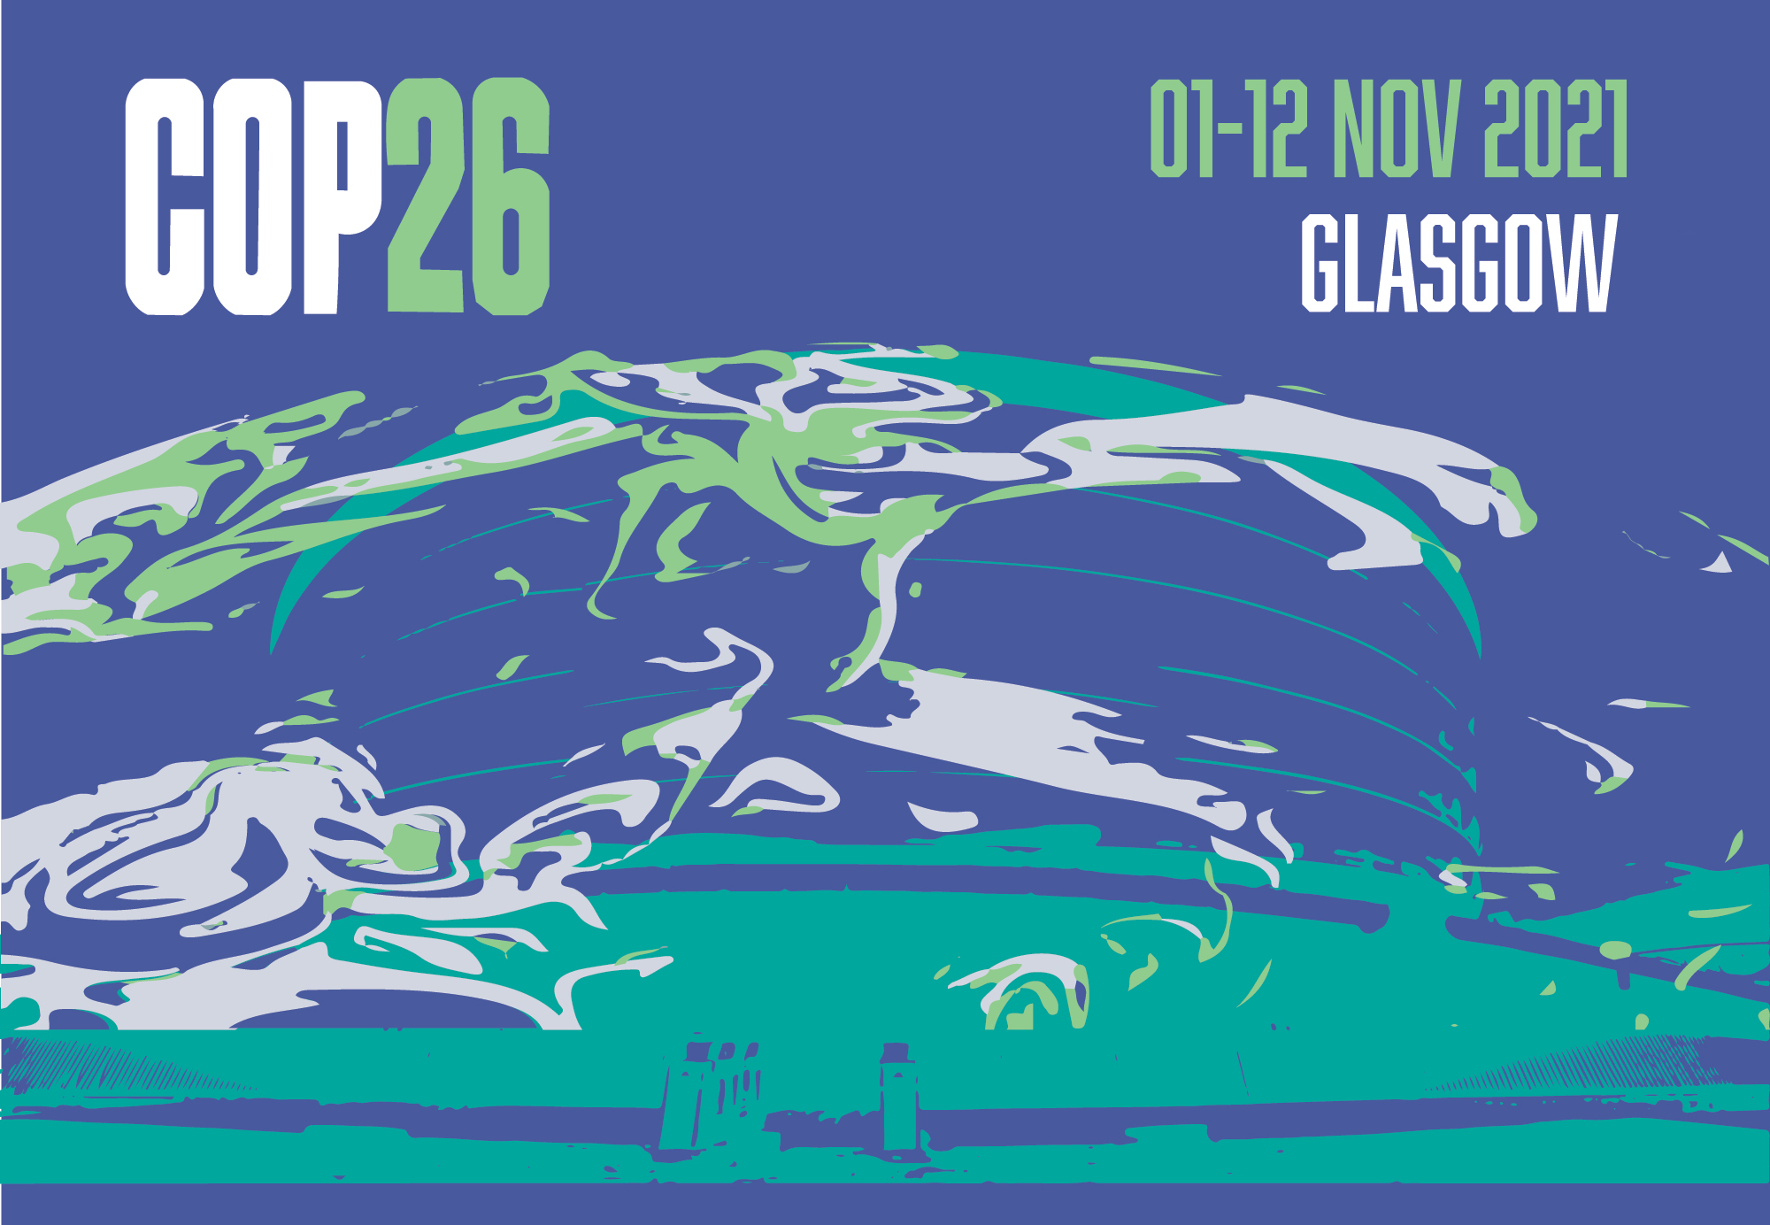

Slide 2
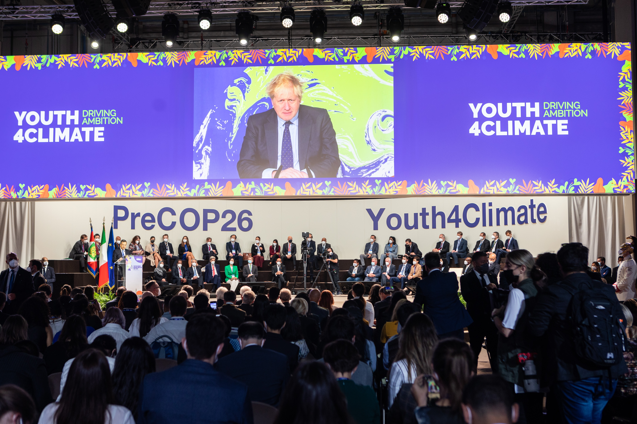
UK Prime Minister in a video message to the Youth4Climate conference in Milan

Slide 3
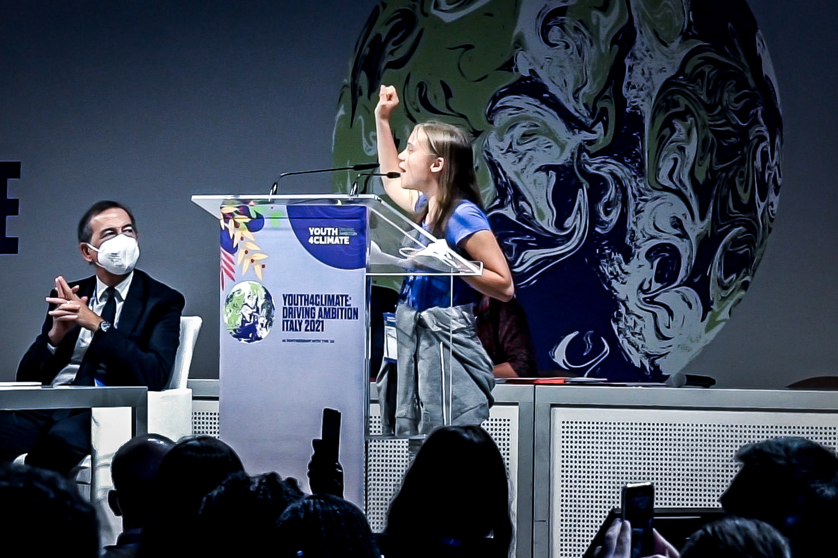
Greta Thunberg speaks in Milan

Slide 4
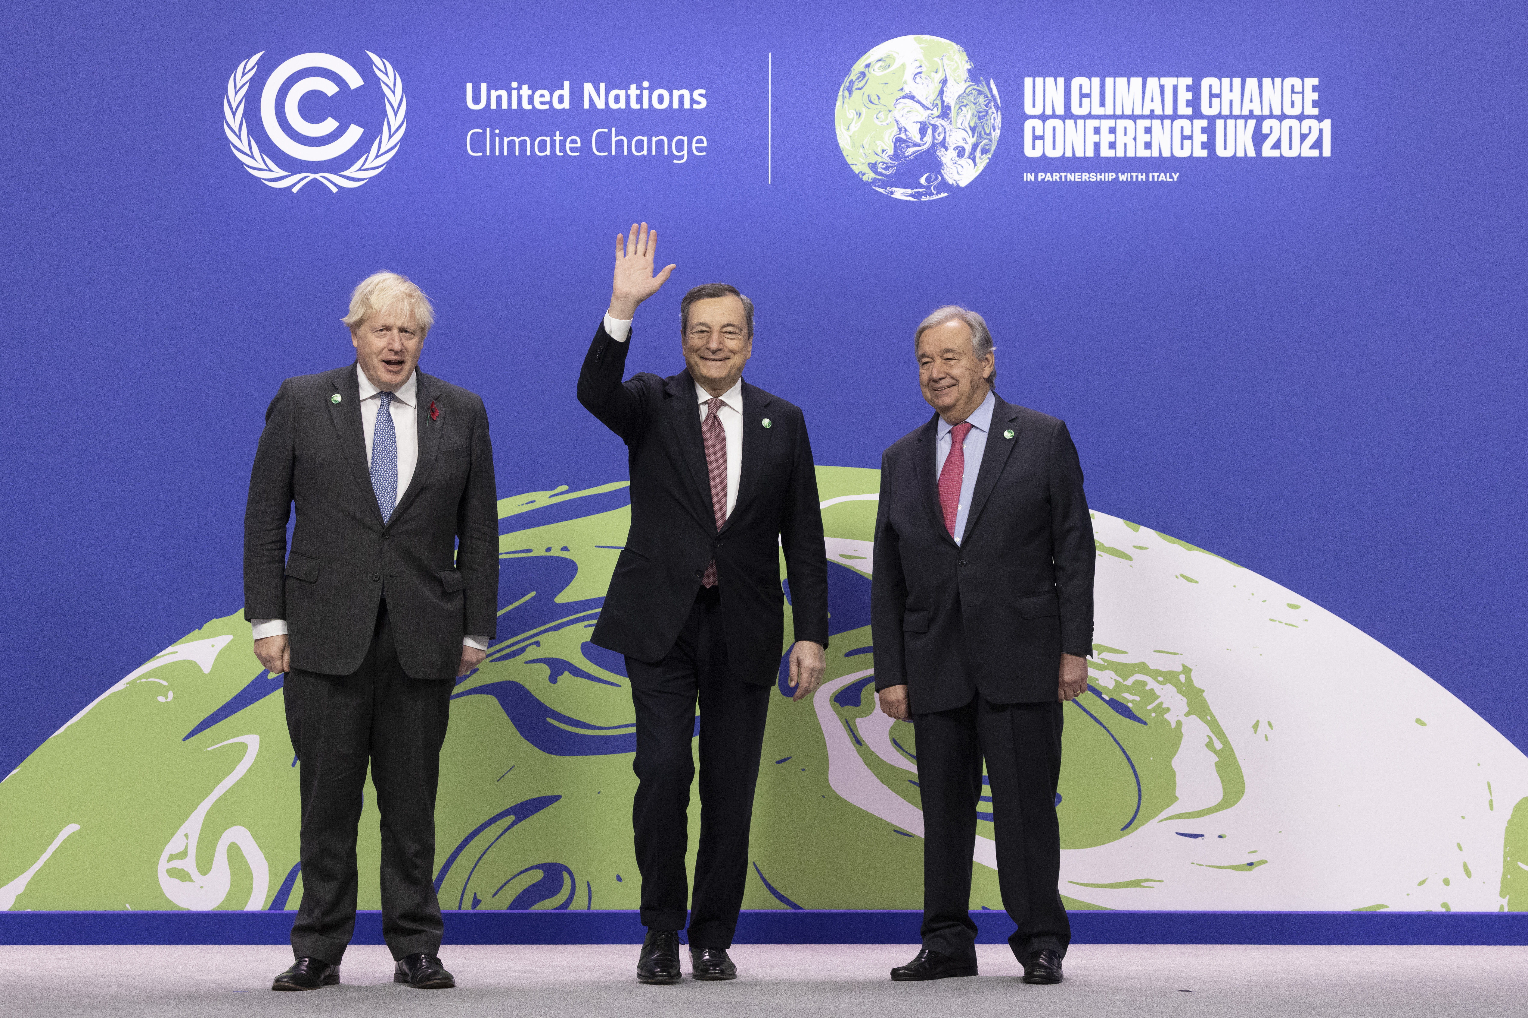
Johnson, Draghi and UN Secretary-General Guterrez in Glasgow

Slide 5
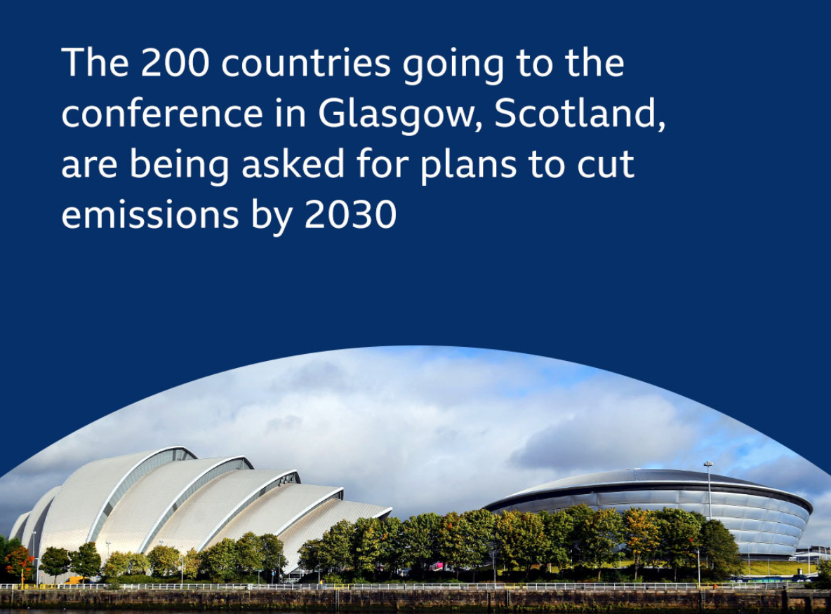

Slide 6
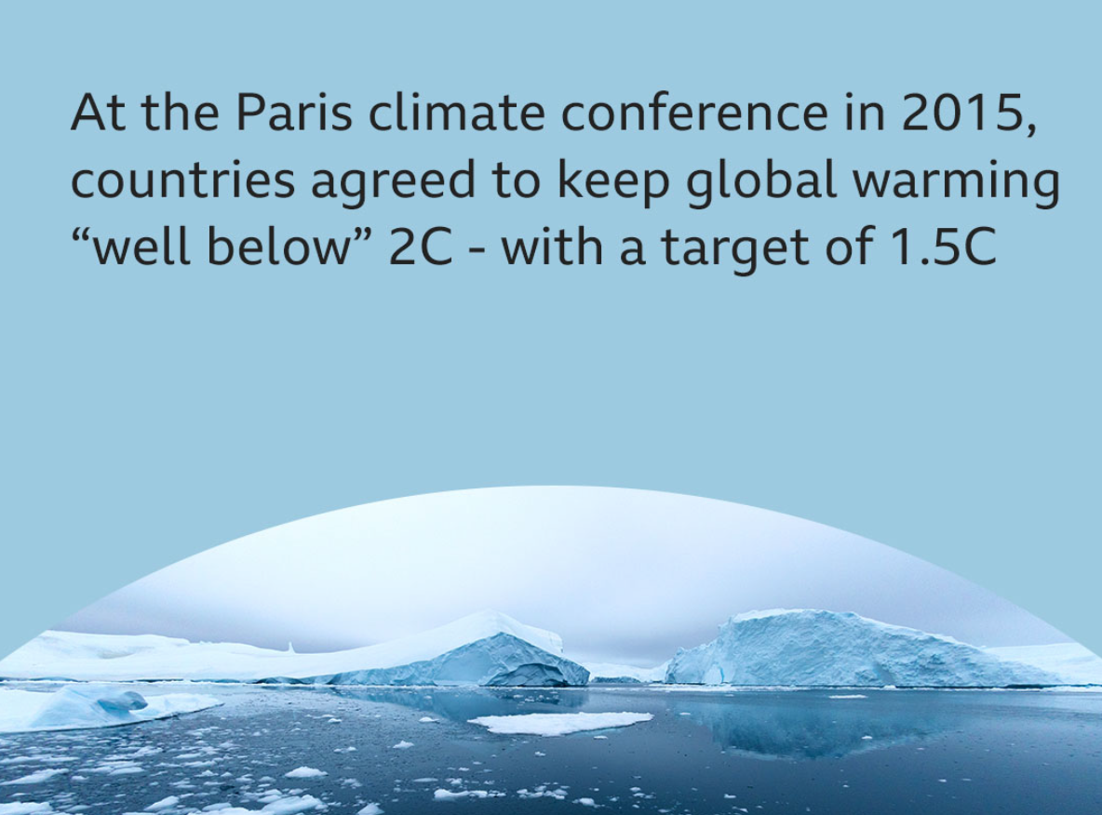

Slide 7
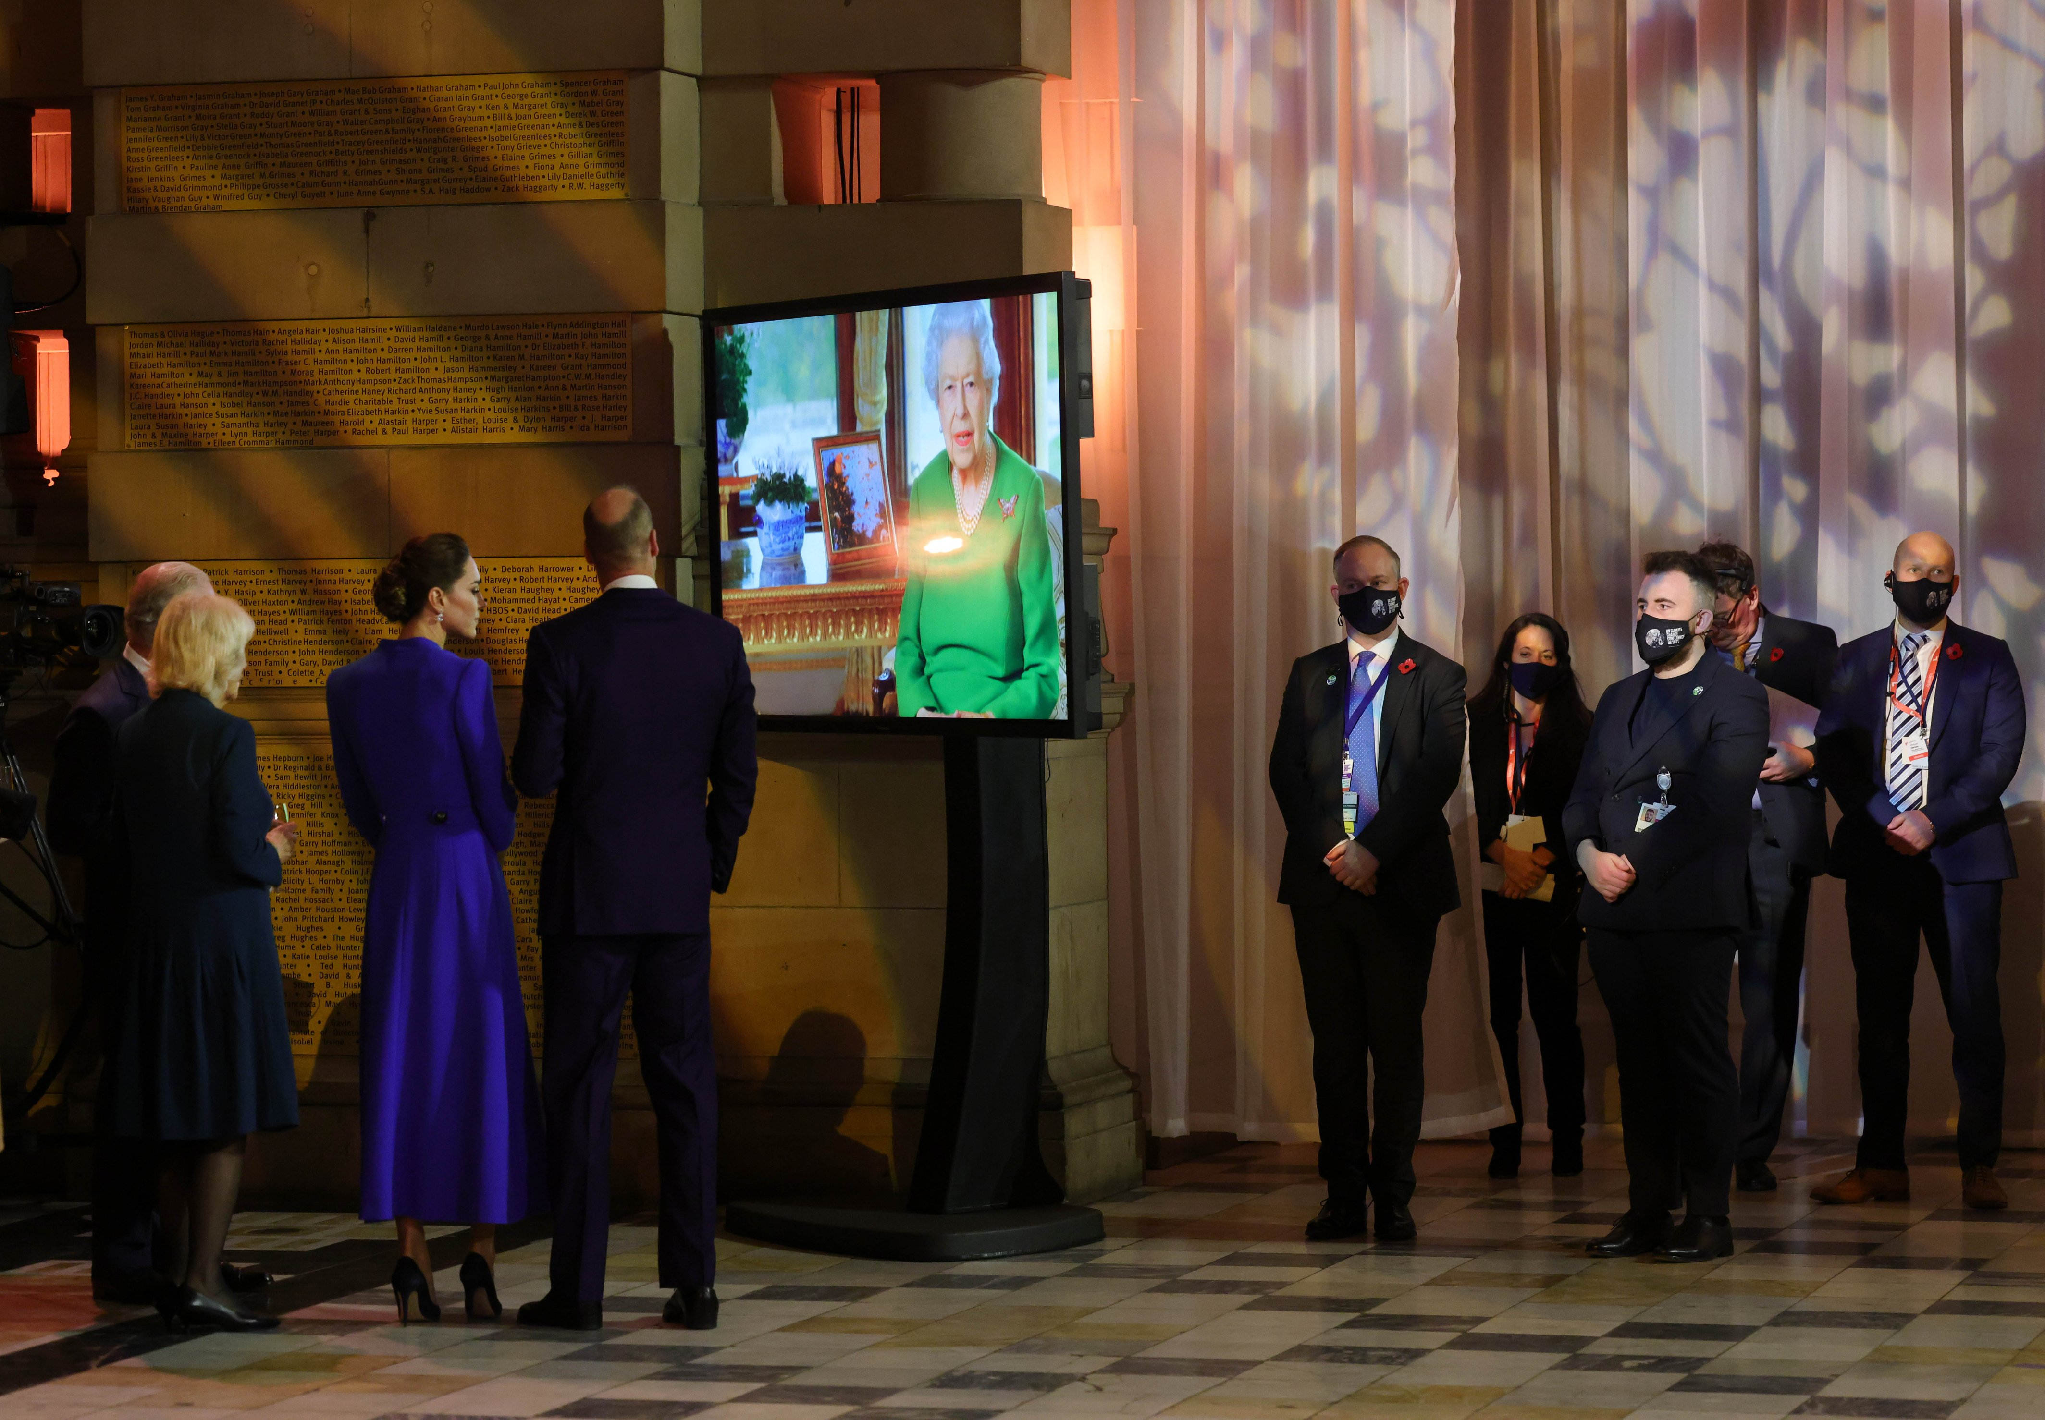
Queen Elizabeth II in a video speech to the Glasgow conference

